Slide 1
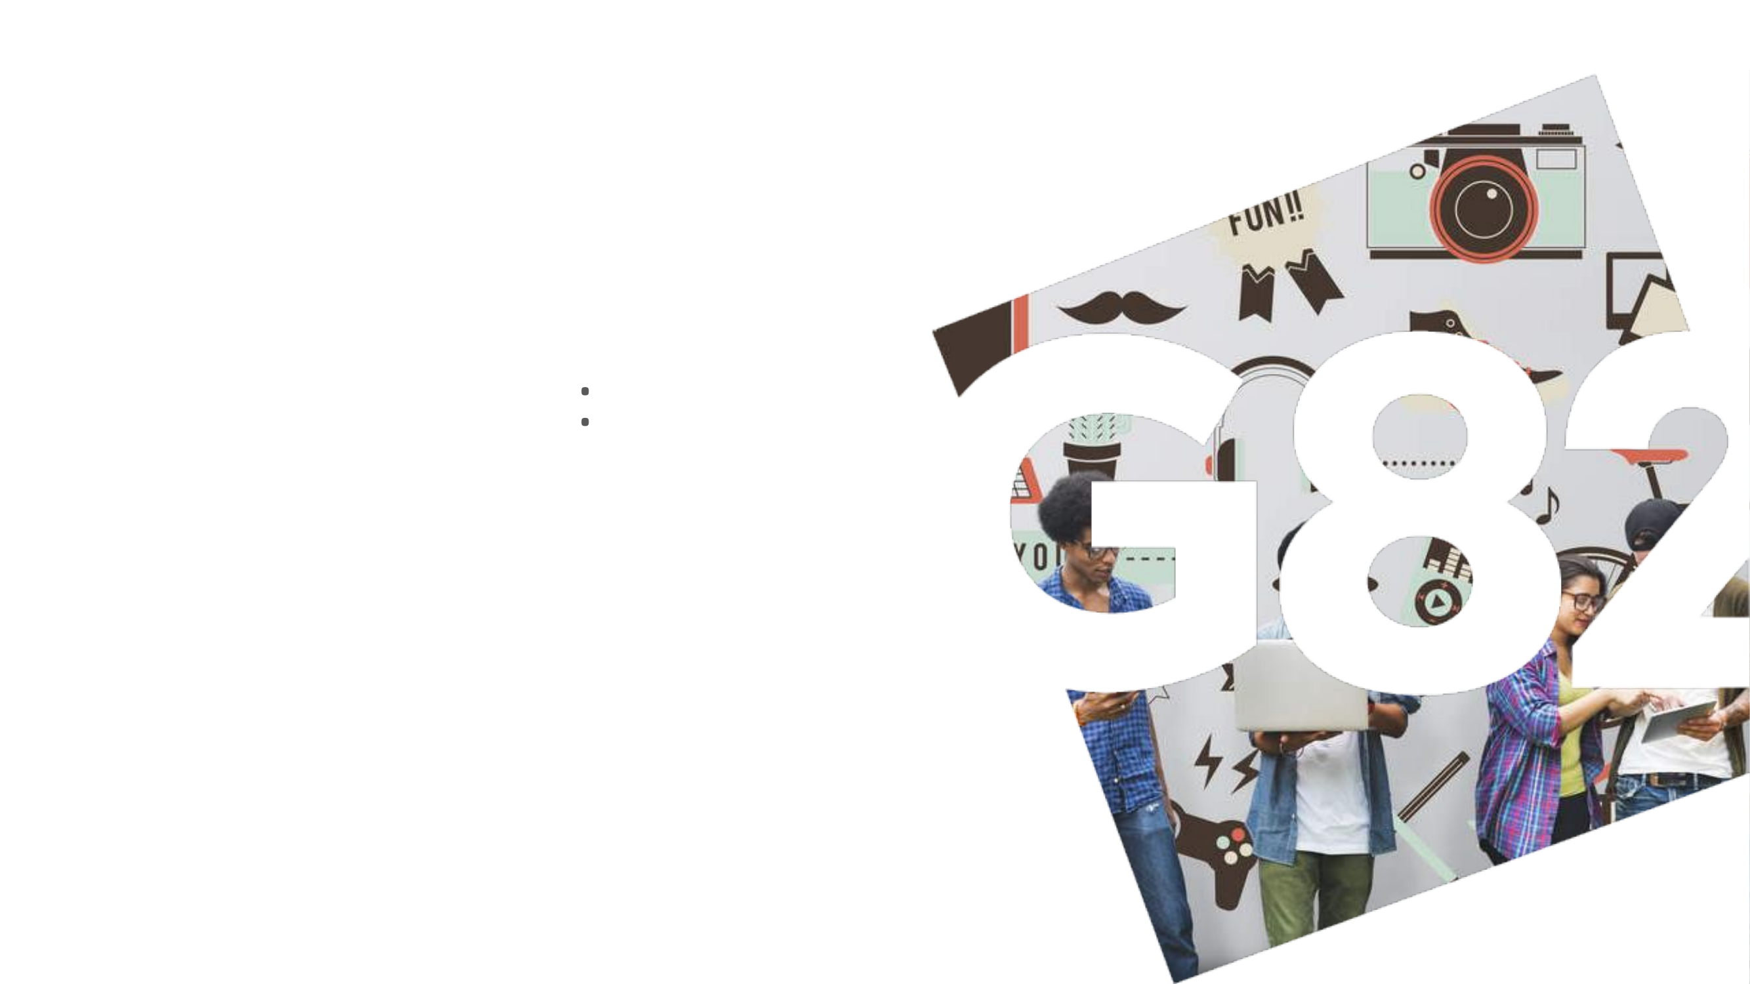
Corporate Culture:
Gen Z perceptions vs. experienced managers
December 2024

Slide 2
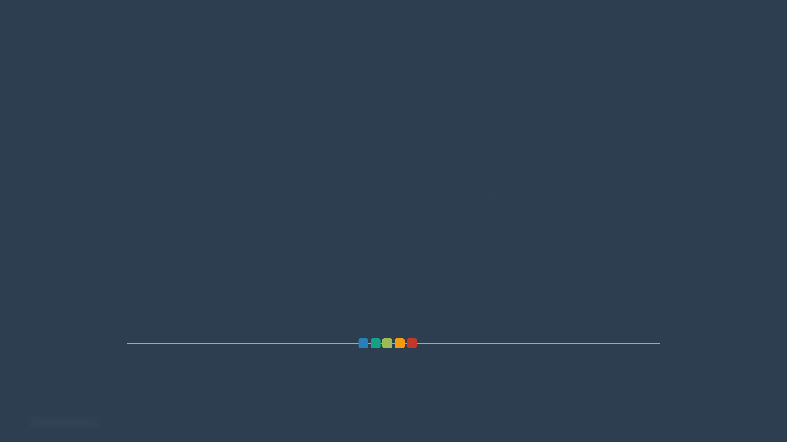
Sample Composition
2 / Corporate Culture

Slide 3
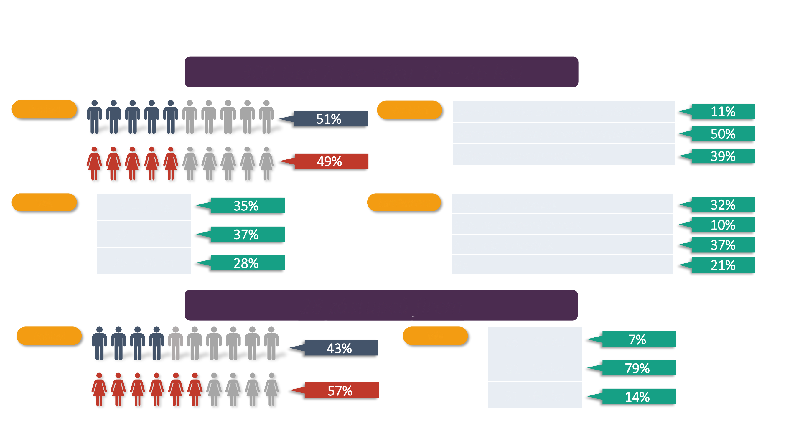
Survey participants
300 Gen Z (aged 18–26)
Gender
Education
I'm a secondary school / vocational school student
I'm a university / college student
I'm not a student
Age
18–21 years
Employment
Yes, full-time
Yes, part-time
22–24 years
Yes, as a casual worker
25–26 years
No
28 company representatives
Gender
Age
18–30 years
31–50 years
51–65 years
3 / Corporate Culture

Slide 4

Introduction to the Competing Values Framework of corporate culture
4 / Corporate Culture

Slide 5
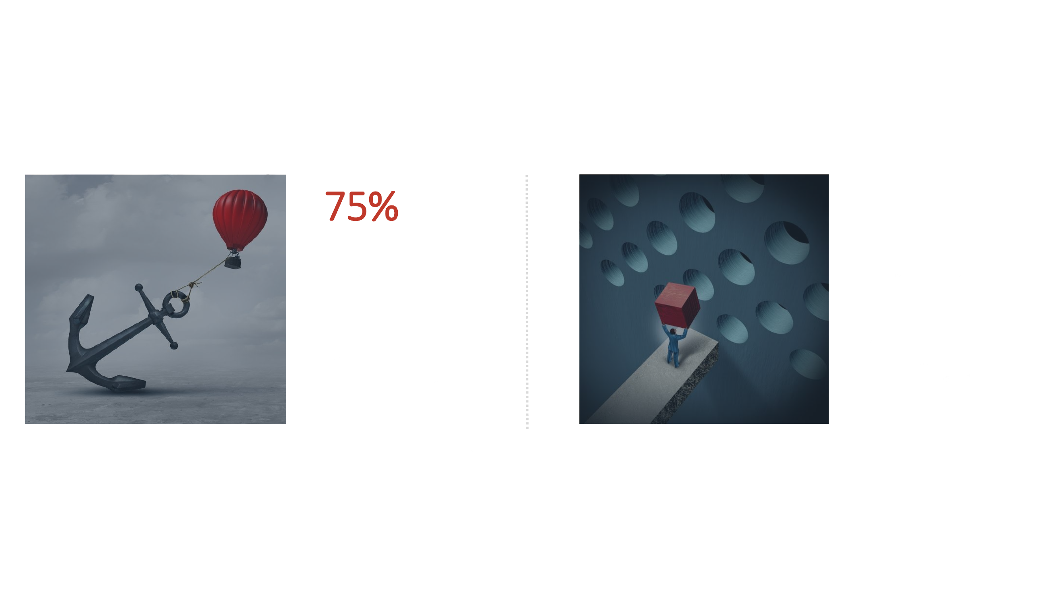
Change vs. corporate culture
Up to three-quarters of reengineering attempts, TQM implementations, strategy changes, or cost-reduction initiatives fail outright or create problems serious enough to threaten the company's survival.
The most common cause of failure is the inability to change the corporate culture.
(Caldwell, 1994; CSC Index, 1994; Gross, Pascale, and Athos, 1993; Kotter and Heskett, 1992)
(Cameron, 1997)
5 / Corporate Culture

Slide 6
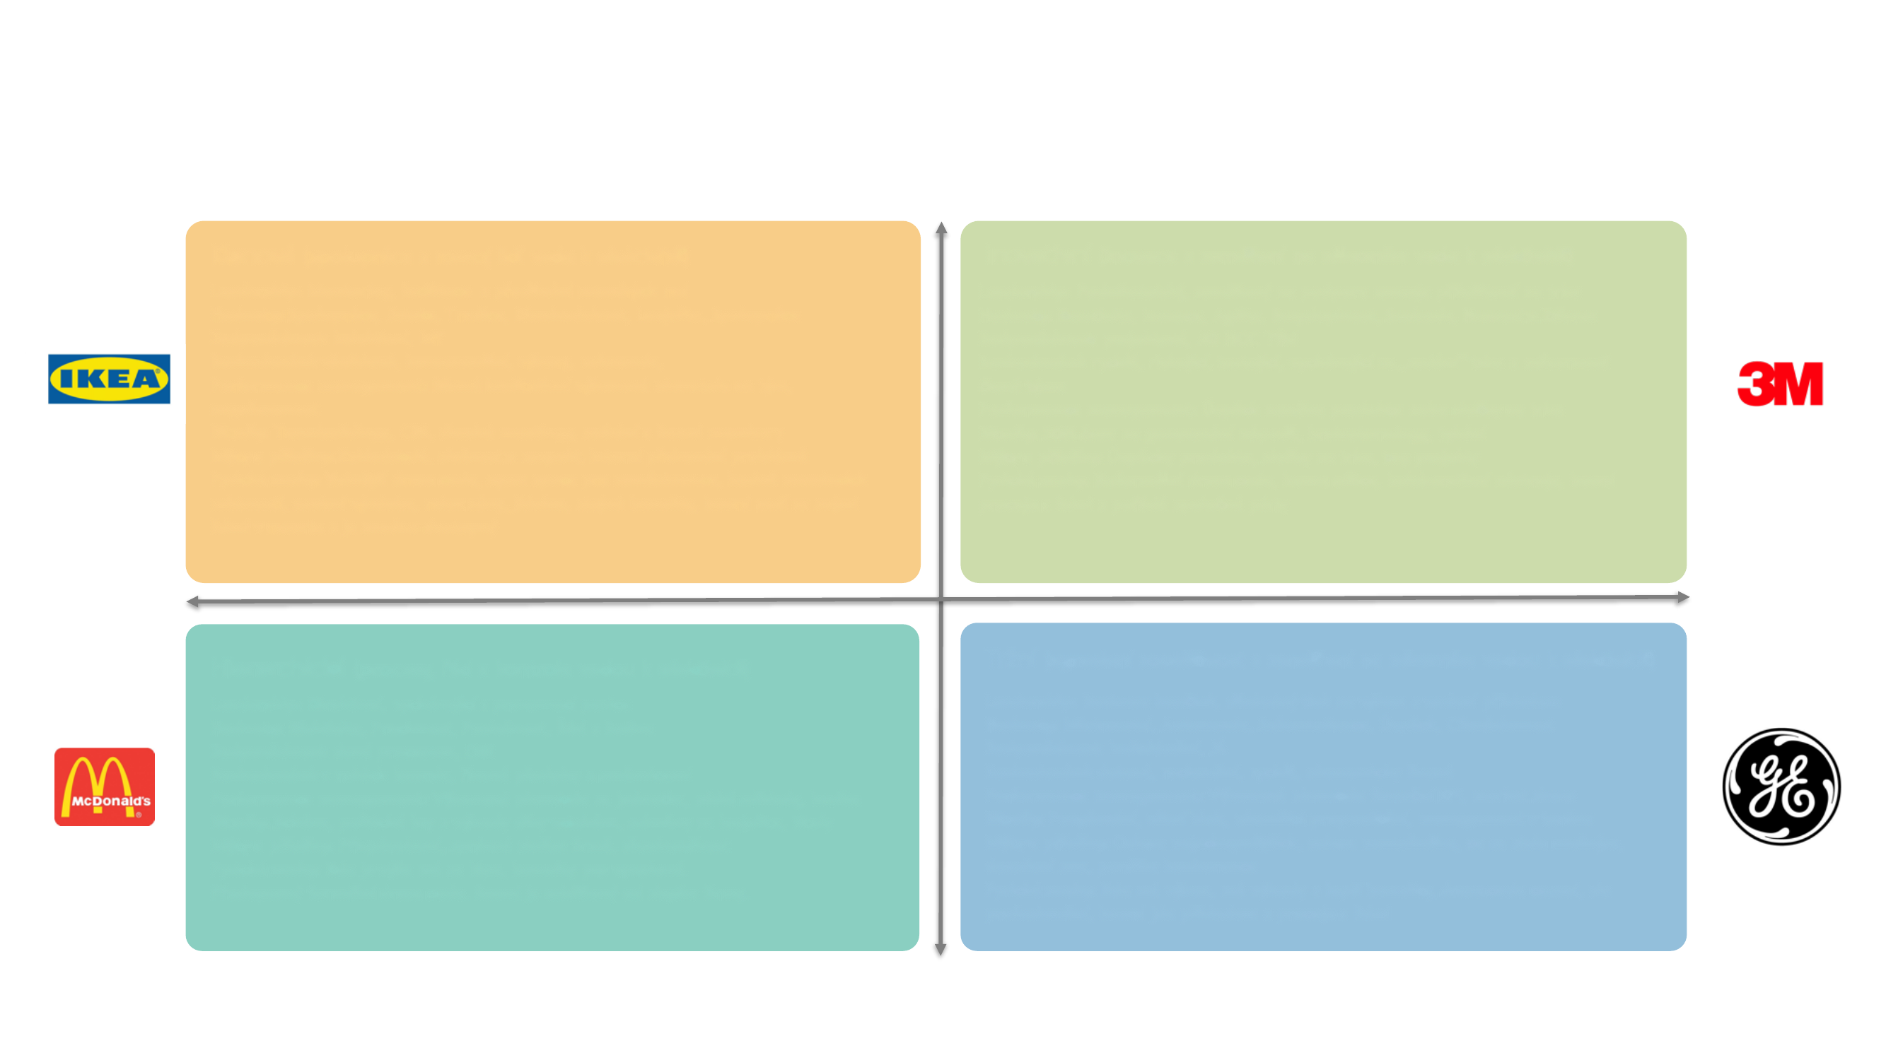
4 cultures: the Competing Values Framework
The Competing Values Framework of corporate culture is built on a space with two dimensions:
Flexibility and discretion
Clan (collaboration and people development drive effectiveness)
Innovative (innovation and customer focus drive effectiveness)
Leadership: Mentoring, facilitation, and passing on wise advice​ Values: Collaboration, Trust, Tradition, Long-term view, Loyalty, Teamwork​ Accountability: collective, WE​ Decision-making: participative, consensual, committees, referenda Performance management: Various qualitative team performance indicators​, engagement Rituals: Team-building, CSR, long meetings, meetings with board members Myths and stories: Founders, decency and respect, overcoming internal problems​ Physical traits: Relaxed dress code, open space for staff, plenty of meeting rooms, personal decoration, relax zones, cafeteria, equal benefits, the board sits with its people in the department and is easily accessible​
Leadership: Entrepreneurial, focused on supporting the development of market opportunities​ Values: Creativity, Innovation, Agility, Purpose, Freedom, Playfulness and Fun​ Accountability: project-based, AD HOC TEAM​ Decision-making: fast, risk-taking, testing, driven by market "demands" and team members' expertise​ Performance management: Success of a new product or service on the market​ Rituals: 20% of time spent generating ideas, brainstorming, first-name basis​ Myths and stories: Product successes, market successes, top projects​ Physical traits: Informal dress code, home office, collaborative tools, the board works with people and hosts joint parties
Internal focus
External focus
Hierarchical (processes, order, and control drive effectiveness)
Market (aggressive competitiveness and customer focus drive effectiveness)
Leadership: Directive, based on positional authority​ Values: Efficiency, Precision, Obedience, Order and Routine​ Accountability: process-defined, THEM​ Decision-making: in the board's hands, governed by rules and directives​ Performance management: Per-unit performance indicators​, low costs, quality Rituals: Meetings, office politics and relationship-based perks, loyalty rewards, titles​ Myths and stories: Conformity, faithful service to the company, longevity​ Physical traits: Those higher up have it better, perks for the chosen few. Prescribed formal dress code. The board is separated from the rest of the company.​
Leadership: Business coaching, consistent pressure on performance and leading by example​ Values: Mastery, Autonomy, Self-motivation, Achievement​, Ambition Accountability: individual, ME​ Decision-making: data-driven, rational, fast, economically driven​ Performance management: Financial KPI performance indicators​, market share Rituals: Promotions, elite club, instant dismissals, management in the field​ Myths and stories: Celebrating top performers, celebrating the impossible made possible, achieving the dream, beating the competition​ Physical traits: Whoever performs gets perks and better benefits, casual but professional dress code, the board leads by example and works with people
Stability and control
6 / Corporate Culture

Slide 7
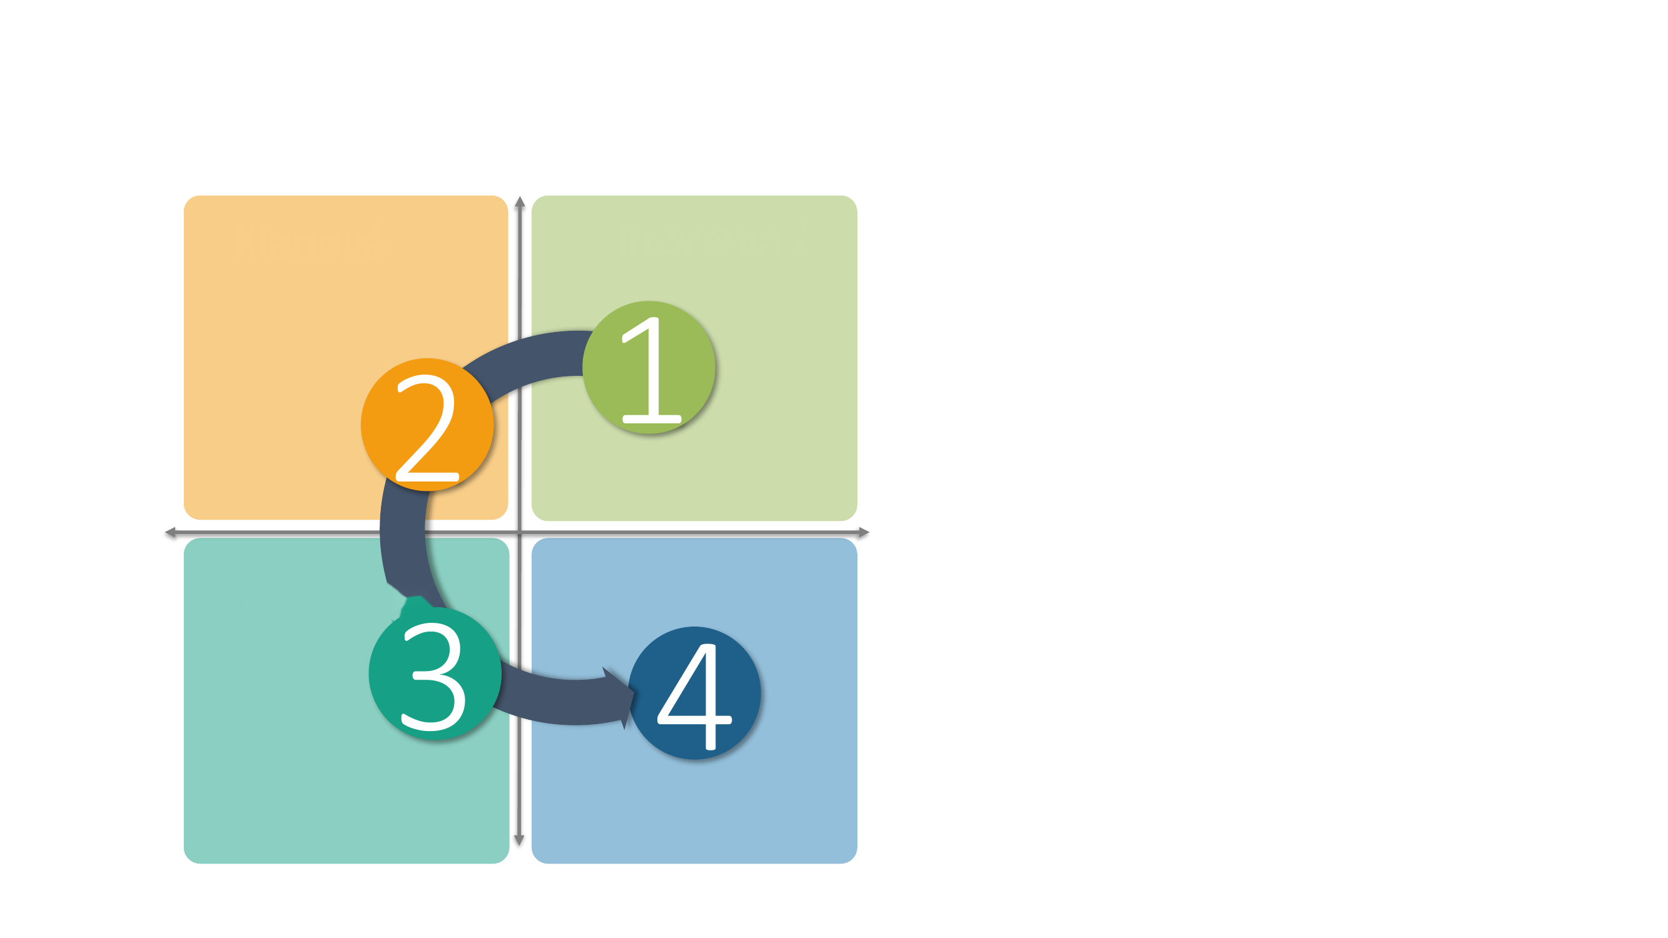
Corporate culture in motion over a company's lifetime
Flexibility and discretion
Clan
Innovative
Every company's culture evolves. Apple is a good example, and we'll walk through its cycle next.
Internal focus
External focus
Hierarchical
Market
Stability and control
7 / Corporate Culture

Slide 8
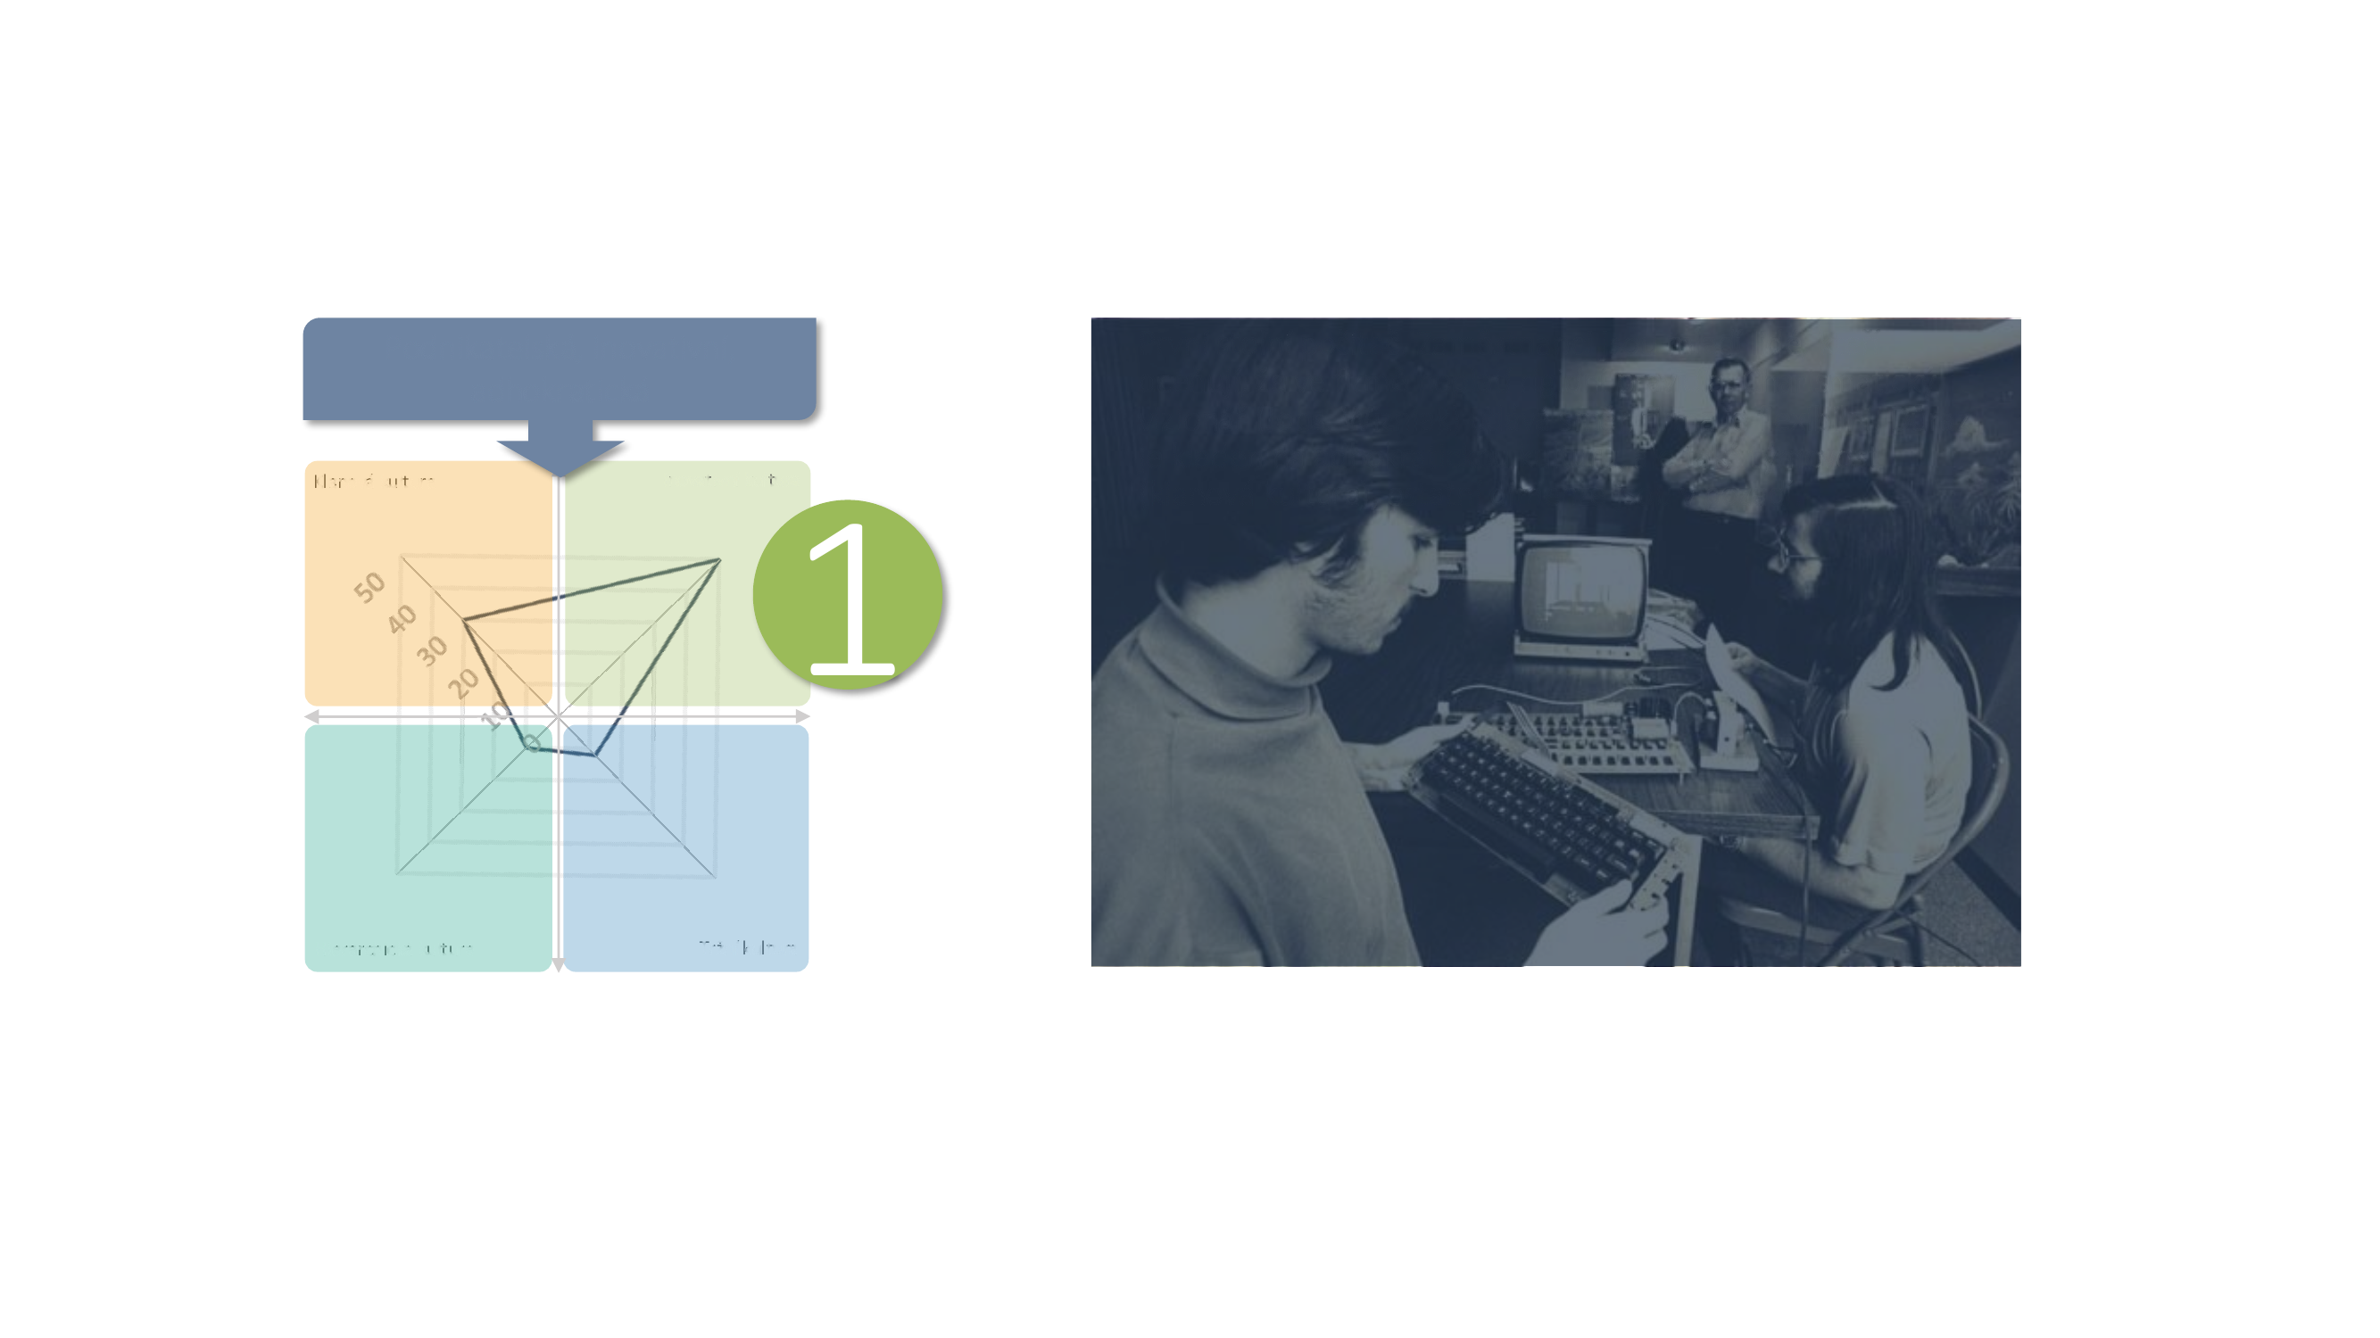
Apple, phase 1: Innovative culture
Entrepreneurial, innovative, adhocratic
The first desktop computer. Employees are young people who value that rigid rules don't apply at the company. A charismatic visionary (Jobs, Wozniak) sets the direction, and the company is flexible. The emphasis is on an adhocratic culture, but also on teamwork (clan culture); the other dimensions stay in the background.
Clan culture
Innovative culture
Hierarchical culture
Market culture
8 / Corporate Culture

Slide 9
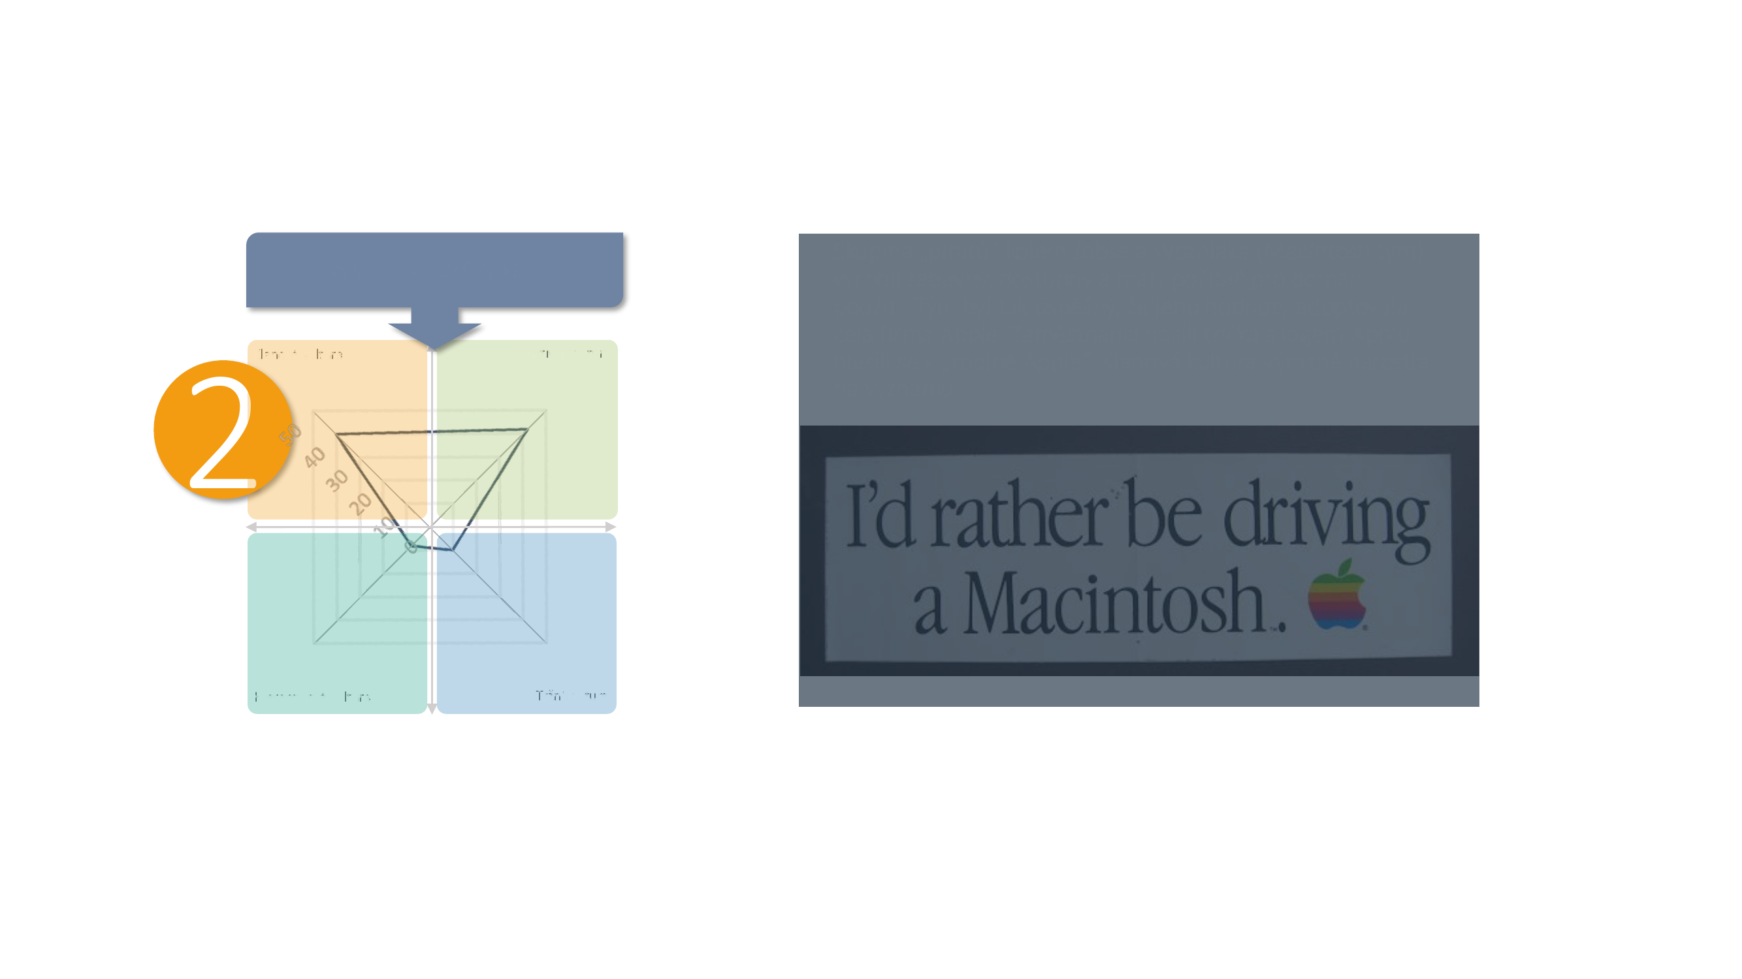
Apple, phase 2: Clan culture
A highly cohesive clan
A group of "pirates" around Jobs and Wozniak (the Macintosh team) built a fun, affordable, small computer for home use. The team was so successful that its values were adopted by the entire company. Employees wore t-shirts with the Apple logo and identified as part of the "Apple family." Clan culture grew significantly in importance.
Clan culture
Innovative culture
Hierarchical culture
Market culture
9 / Corporate Culture

Slide 10
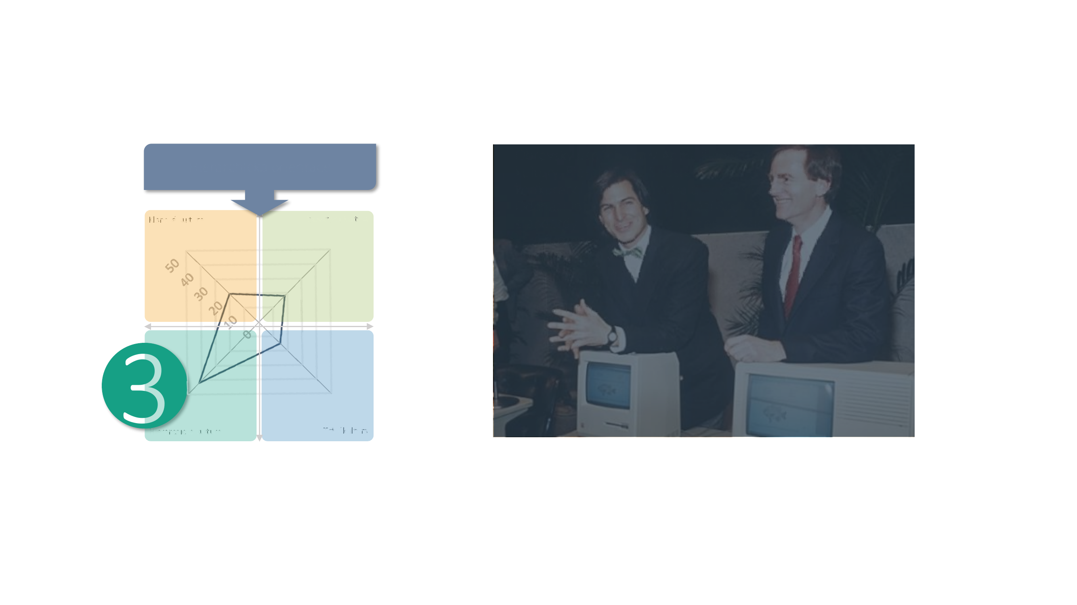
Apple, phase 3: Hierarchical culture
Hierarchical orientation
Apple's enormous success carried it into the next phase of its corporate culture: hierarchical. As sales grew and competition intensified, the importance of standardization and order grew with them. Jobs the visionary departs, and Sculley arrives to establish standards. During this transition Apple went through a massive crisis of corporate identity; people left, others arrived. The transformation was drastic. Sculley managed it thanks to his exceptional abilities. But had the company stayed anchored in a hierarchical culture, the next wave of success would not have been possible. Another shift awaited the company.
Clan culture
Innovative culture
Hierarchical culture
Market culture
10 / Corporate Culture

Slide 11
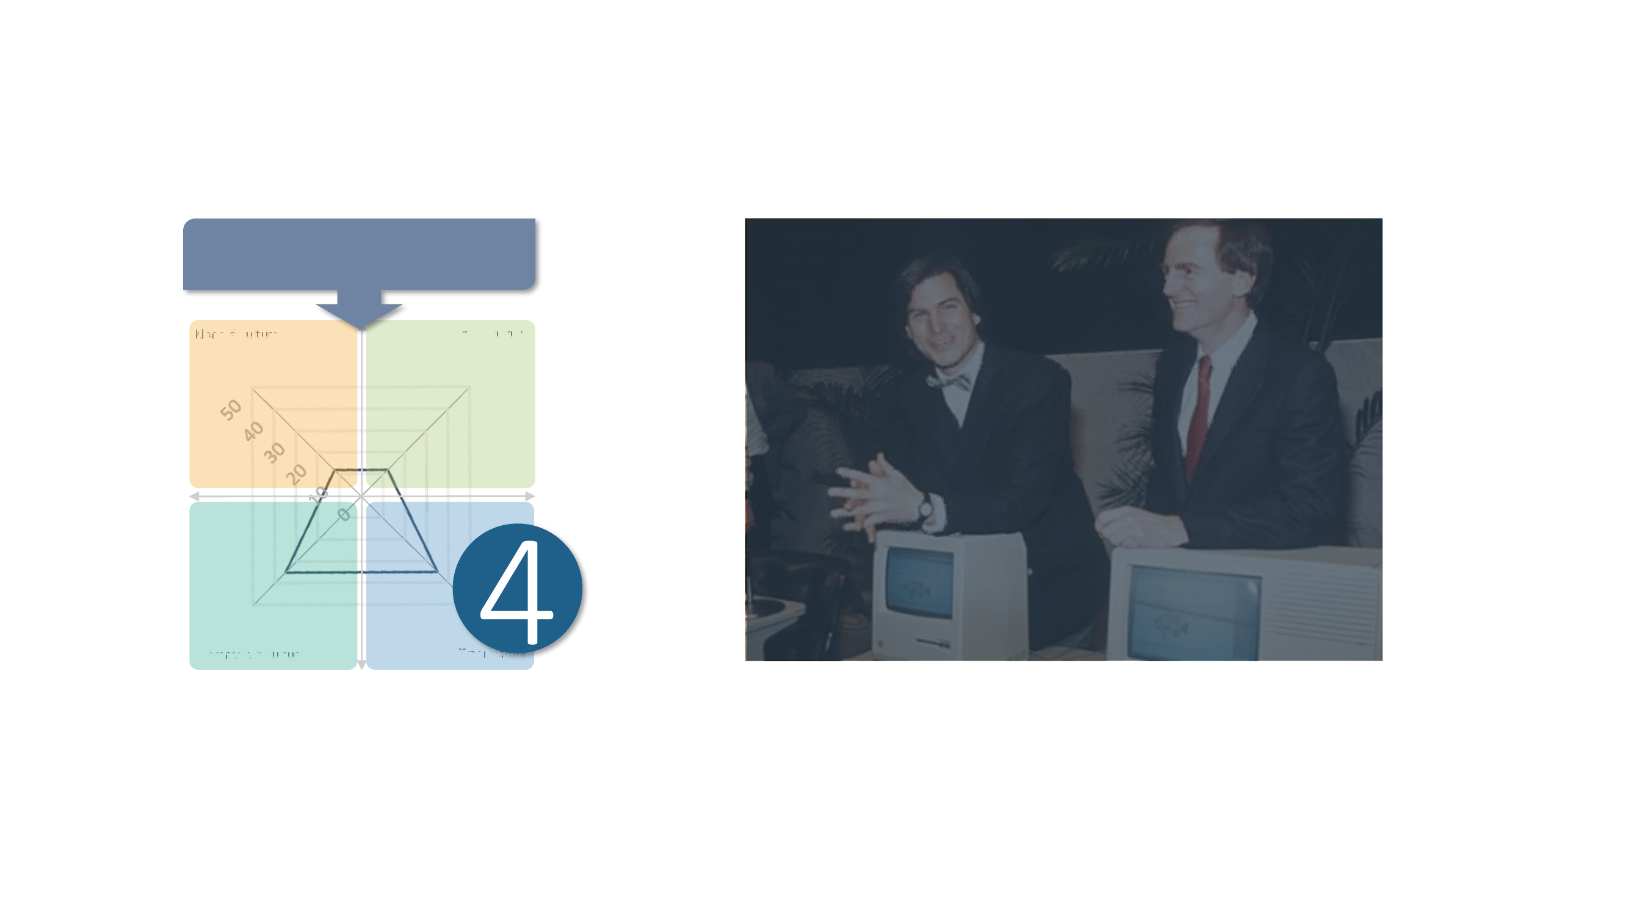
Apple, phase 4: Market culture
Apple stopped being the agile, innovative company it was in its early life, and instead became an outstanding example of efficiency and clever marketing. A model that suppresses clan and innovative culture became more or less the standard, and many advisors focused on how to convert elements of clan and innovative culture into a more stable market position. But the culture shown on the left also brought Apple plenty of worries. As the market evolved and product life cycles sped up sharply, the company risked a downturn from a lack of dominance in innovation. That finally changed with the arrival of the iPod. The company returned to innovating.
Efficiency and clever marketing
Clan culture
Innovative culture
Hierarchical culture
Market culture
11 / Corporate Culture

Slide 12
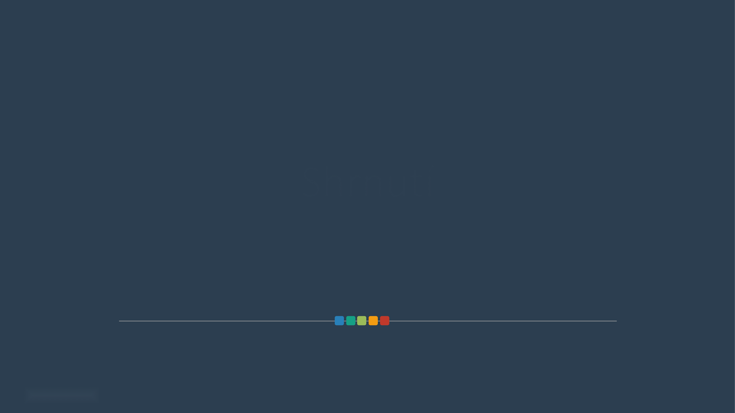
Summary
12 / Corporate Culture

Slide 13

How can an employer win over Gen Z?
Creativity
Security
One for all, all for one
The cosy room
Good relationships come first. The manager should be a mentor, and accountability is collective. The team should be involved in decision-making (voting, compromise) and in rewards (indicators for the whole team). Collaboration, loyalty, and engagement are valued. And they don't mind securing perks through informal relationships, either.
Is creativity this generation's magic word? Yes and no. The emphasis should be on generating ideas, brainstorming, freedom, playfulness​. Creativity and agility should be rewarded. The success of new products on the market can be part of the company's lore. But above all, not too fast and frantic – the manager should be a calm mentor, and decisions should be made democratically rather than quickly and intuitively.
Work should feel as cosy as working from home. The pandemic, and the changes in work/study habits that came with it, hit a substantial part of their studies and/or working life. They no longer want to go back to a hard office chair. They call for a more relaxed dress code, open-plan space for staff, and plenty of meeting rooms.
It may sound strange, but young people need their sense of security too. Especially when it comes to company values, the firm should recognize tradition, stability, loyal service to the company, long-tenured employees, and the ability to be aligned with the company.
13 / Corporate Culture

Slide 14

What does Gen Z not want at work?
Individual success
Formality
Everyone for themselves
Pressure to perform
Individual accountability stresses them out. Self-motivation, autonomy, and ambition are not their values. They may grow into them as their career successes accumulate. But at the start of their career, they'd rather take shelter in the arms of a friendly team.
Even individual success doesn't appeal to them. They don't want to celebrate the promotion of top performers, mastery, or beating the competition. A promotion shouldn't be a big event. They'd rather pursue their dreams outside their career than within it.
Is "the market" a dirty word? A little. They definitely don't want to push themselves to the limit. They reject pressure to perform, rational data/market-driven decision-making, financial performance indicators, and KPIs. They don't want to put efficiency and precision first. And they don't want to learn on the fly or sound the alarm when things aren't going well.
They don't want formal dress or formal relationships. Top management shouldn't be separated from the rest of the company. A professional environment, precision, order, routine, and obedience hold no appeal for them. They have no interest in a grey, neutral environment.
14 / Corporate Culture

Slide 15
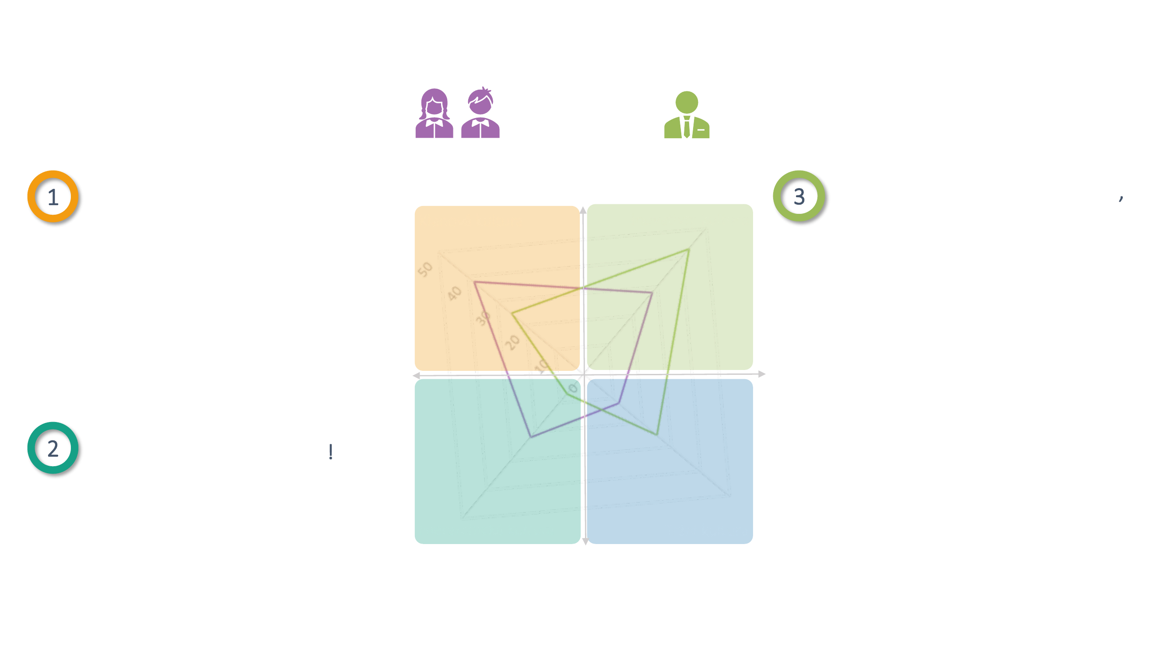
Gen Z's dream company
Gen Z / Company representatives
Young people especially want a clan corporate culture:
38 vs. 25
28 vs. 43
Innovation matters to them too, but (perhaps surprisingly) less than it does to experienced managers.
Clan culture
Innovative culture
➢ Collaboration, community, compromise,
engagement as the yardstick of success
➢ Creativity should be the yardstick of success ➢ Emphasis on generating ideas,
➢ A cosy, home-like environment,
informal dress, open-plan space
brainstorming, agility, freedom, playfulness​
➢ Leadership through mentoring and
passing on useful advice
➢ A product's/service's market success
as a celebrated piece of company lore​
But they also appreciate a touch of hierarchy!
➢ Perks through informal relationships ➢ Loyalty and proper,
long-standing service to the company are valued
Hierarchical culture
Market culture
22 vs. 7
12 vs. 25
15 / Corporate Culture

Slide 16

Diagnosing corporate culture
16 / Corporate Culture

Slide 17
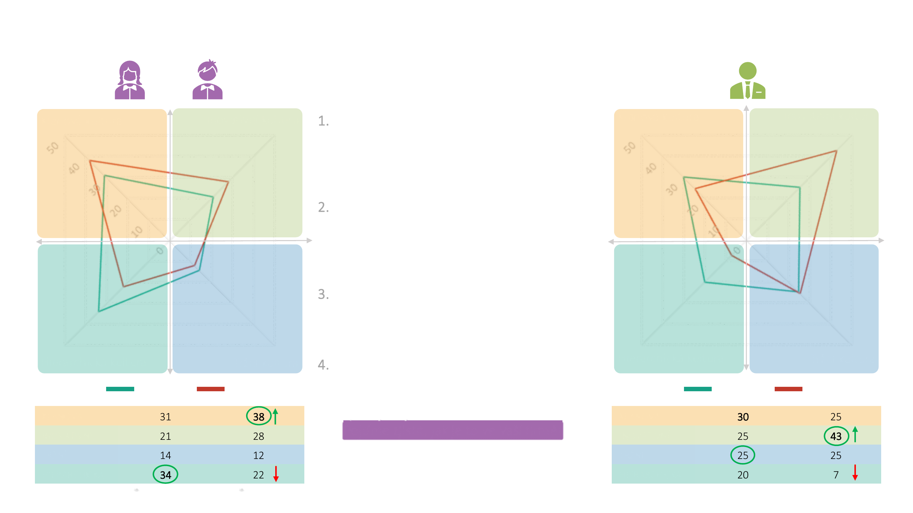
Corporate culture: Gen Z vs. company representatives
4 key takeaways
Gen Z
Company
representatives
Clan culture
Innovative culture
Generation Z prefers a clan corporate culture above all. Both groups also place real weight on innovation. Experienced managers want to weaken clan culture specifically in favor of innovation.
Gen Z rates their companies' current culture as quite hierarchical – perhaps because early in their careers they go through a lot of training and absorb the rules, processes, and procedures.
Both groups want to weaken hierarchy specifically. Young people, though, are more open to it than managers are – for instance, when it comes to gaining perks through informal relationships.
For Gen Z, the current and preferred corporate culture are more aligned than they are for company representatives. Does that make them more satisfied at work? Not necessarily.
Clan culture
Innovative culture
Hierarchical culture
Market culture
Hierarchical culture
Market culture
CURRENT CULTURE
PREFERRED CULTURE
CURRENT CULTURE
PREFERRED CULTURE
CLAN
CLAN
INNOVATIVE
Let's find out how it looks in your company!
INNOVATIVE
MARKET
Bold = highest number in the column Arrows = what they want to weaken/strengthen in the preferred culture versus the current one Circles = the biggest difference between Gen Z and company representatives
MARKET
HIERARCHICAL
HIERARCHICAL
17 / Corporate Culture
Base: young people who work
Base: all young people

Slide 18
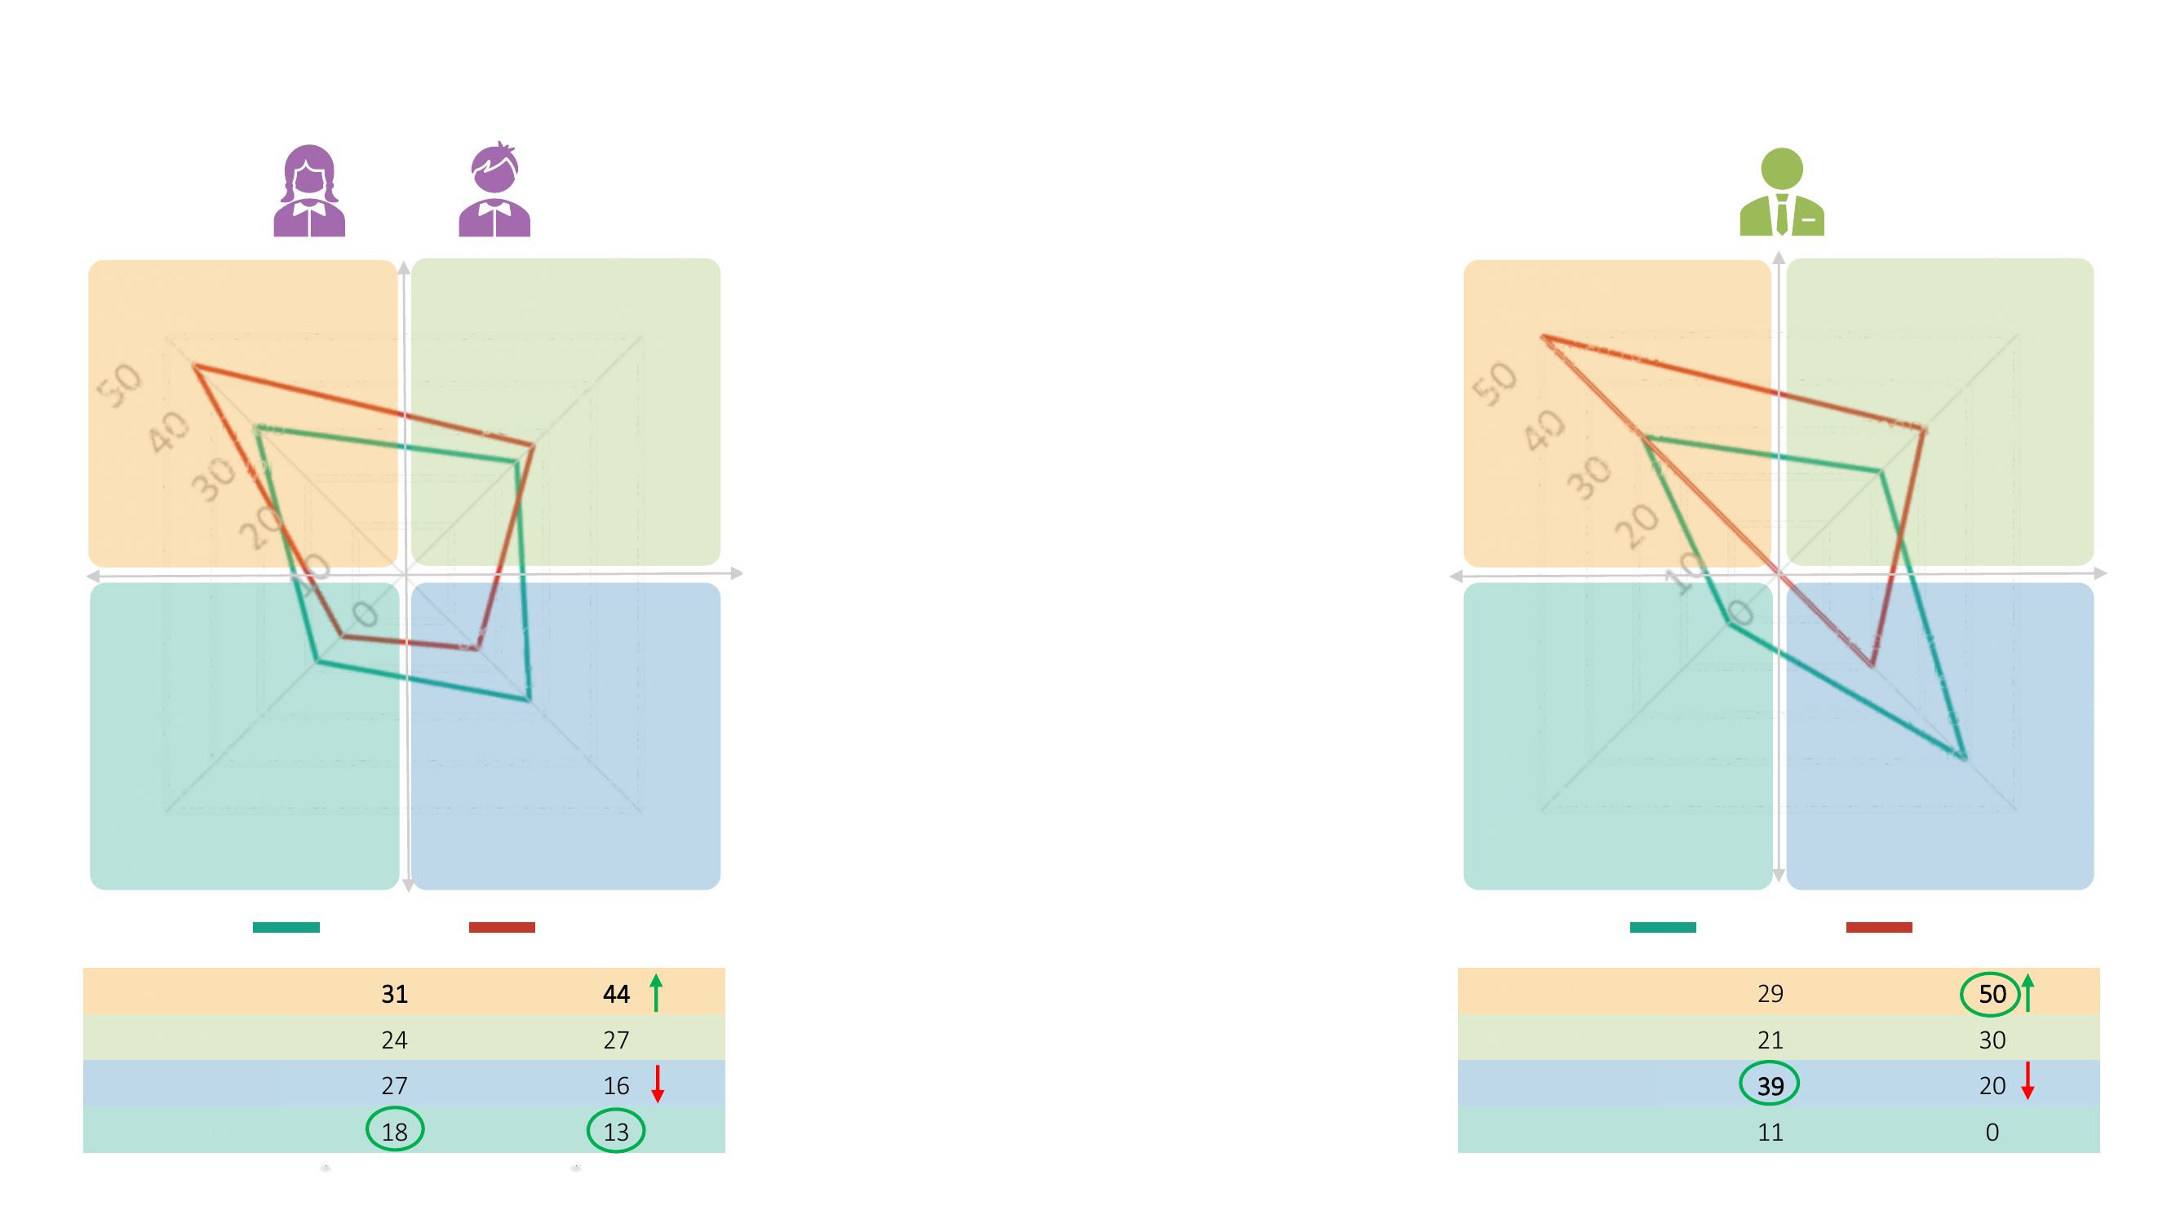
Leadership style
Gen Z
Company
representatives
Mentoring, passing on useful advice. Managers are easily accessible and have their own agenda
Help finding opportunities. Managers are right there in the team and share the same agenda as the rest of the team
Young people clearly prefer mentoring and
Mentoring, passing on useful advice. Managers are easily accessible and have their own agenda
Help finding opportunities. Managers are right there in the team and share the same agenda as the rest of the team
passing on useful advice. Leadership has its own
work agenda (that is, it doesn't work on the same tasks as the rest of the team), but it's easily accessible for questions and discussion.
The leadership style at their current job basically matches what they'd like, though they would welcome even more mentoring. Conversely, they'd like to see less pressure to perform and less learning on the fly.
Learning "on the fly," consistent pressure to perform, and leading by example​. Managers are among the people and set both the pace and the direction
Learning "on the fly," consistent pressure to perform, and leading by example​. Managers are among the people and set both the pace and the direction
Primarily formal, based on positional authority. Managers are "further away" from people
Primarily formal, based on positional authority. Managers are "further away" from people
They agree here with company representatives, who feel the consistent pressure to perform even more strongly.
CURRENT CULTURE
PREFERRED CULTURE
CURRENT CULTURE
PREFERRED CULTURE
CLAN
CLAN
INNOVATIVE
INNOVATIVE
MARKET
Bold = highest number in the column Arrows = what they want to weaken/strengthen in the preferred culture versus the current one Circles = the biggest difference between Gen Z and company representatives
MARKET
HIERARCHICAL
HIERARCHICAL
18 / Corporate Culture
Base: young people who work
Base: all young people

Slide 19
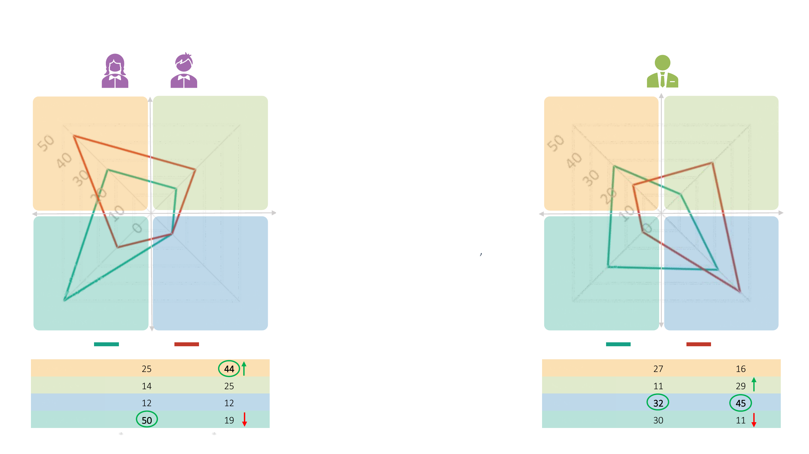
Decision-making
Gen Z
Company
representatives
More people involved, compromise, voting, and so on
Fast, calmly and intuitively, drawing on the expertise of team members
Young people clearly prefer collective, democratic decision-making – involving the whole
More people involved, compromise, voting, and so on
Fast, calmly and intuitively, drawing on the expertise of team members
team, compromise, voting, and so on.
In doing so, they're asking for more involvement, because at their current job, decisions most often lie with management, which follows established practices. That's what young people want to change.
They differ sharply here from managers, who prefer rational decision-making based on data and market analysis. Their experience tells them that democracy has no place in company practice.
In the hands of clearly designated managers; decisions follow established practices
In the hands of clearly designated managers; decisions follow established practices
Based on data, rationally, driven by the market
Based on data, rationally, driven by the market
CURRENT CULTURE
PREFERRED CULTURE
CURRENT CULTURE
PREFERRED CULTURE
CLAN
CLAN
INNOVATIVE
INNOVATIVE
MARKET
Bold = highest number in the column Arrows = what they want to weaken/strengthen in the preferred culture versus the current one Circles = the biggest difference between Gen Z and company representatives
MARKET
HIERARCHICAL
HIERARCHICAL
19 / Corporate Culture
Base: young people who work
Base: all young people

Slide 20
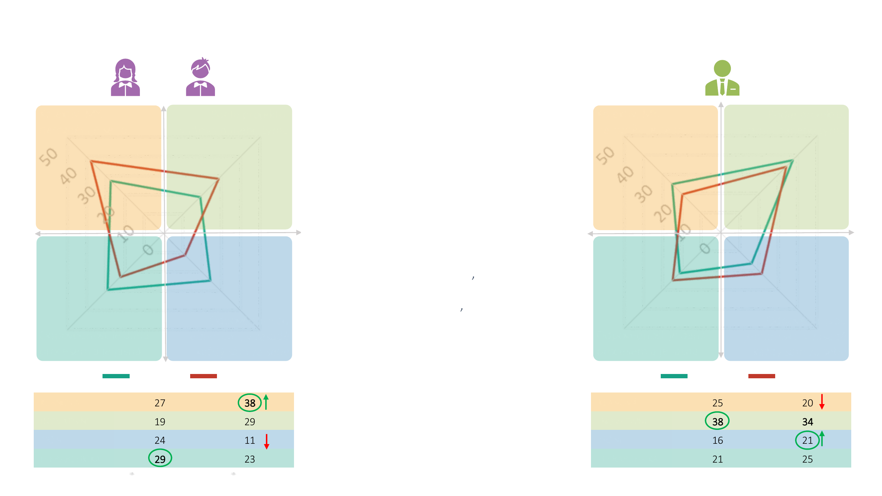
Accountability
Gen Z
Company
representatives
The group, WE, it isn't divided up
By project, within the given team
Young people also think accountability should be
The group, WE, it isn't divided up
By project, within the given team
shared – carried by the whole group, or by the team
working on the project.
This collective aspect is missing at their current job – accountability is too individual, which likely fuels their stress and fear of failure.
They differ here from managers, who in this respect too want to weaken the democratic approach and strengthen
individual, or team-based, accountability
Individuals are accountable; basically, everyone for themselves
based on the project.
Individuals are accountable; basically, everyone for themselves
Accountability is defined by the process and is clear
Accountability is defined by the process and is clear
CURRENT CULTURE
PREFERRED CULTURE
CURRENT CULTURE
PREFERRED CULTURE
CLAN
CLAN
INNOVATIVE
INNOVATIVE
MARKET
Bold = highest number in the column Arrows = what they want to weaken/strengthen in the preferred culture versus the current one Circles = the biggest difference between Gen Z and company representatives
MARKET
HIERARCHICAL
HIERARCHICAL
20 / Corporate Culture
Base: young people who work
Base: all young people

Slide 21
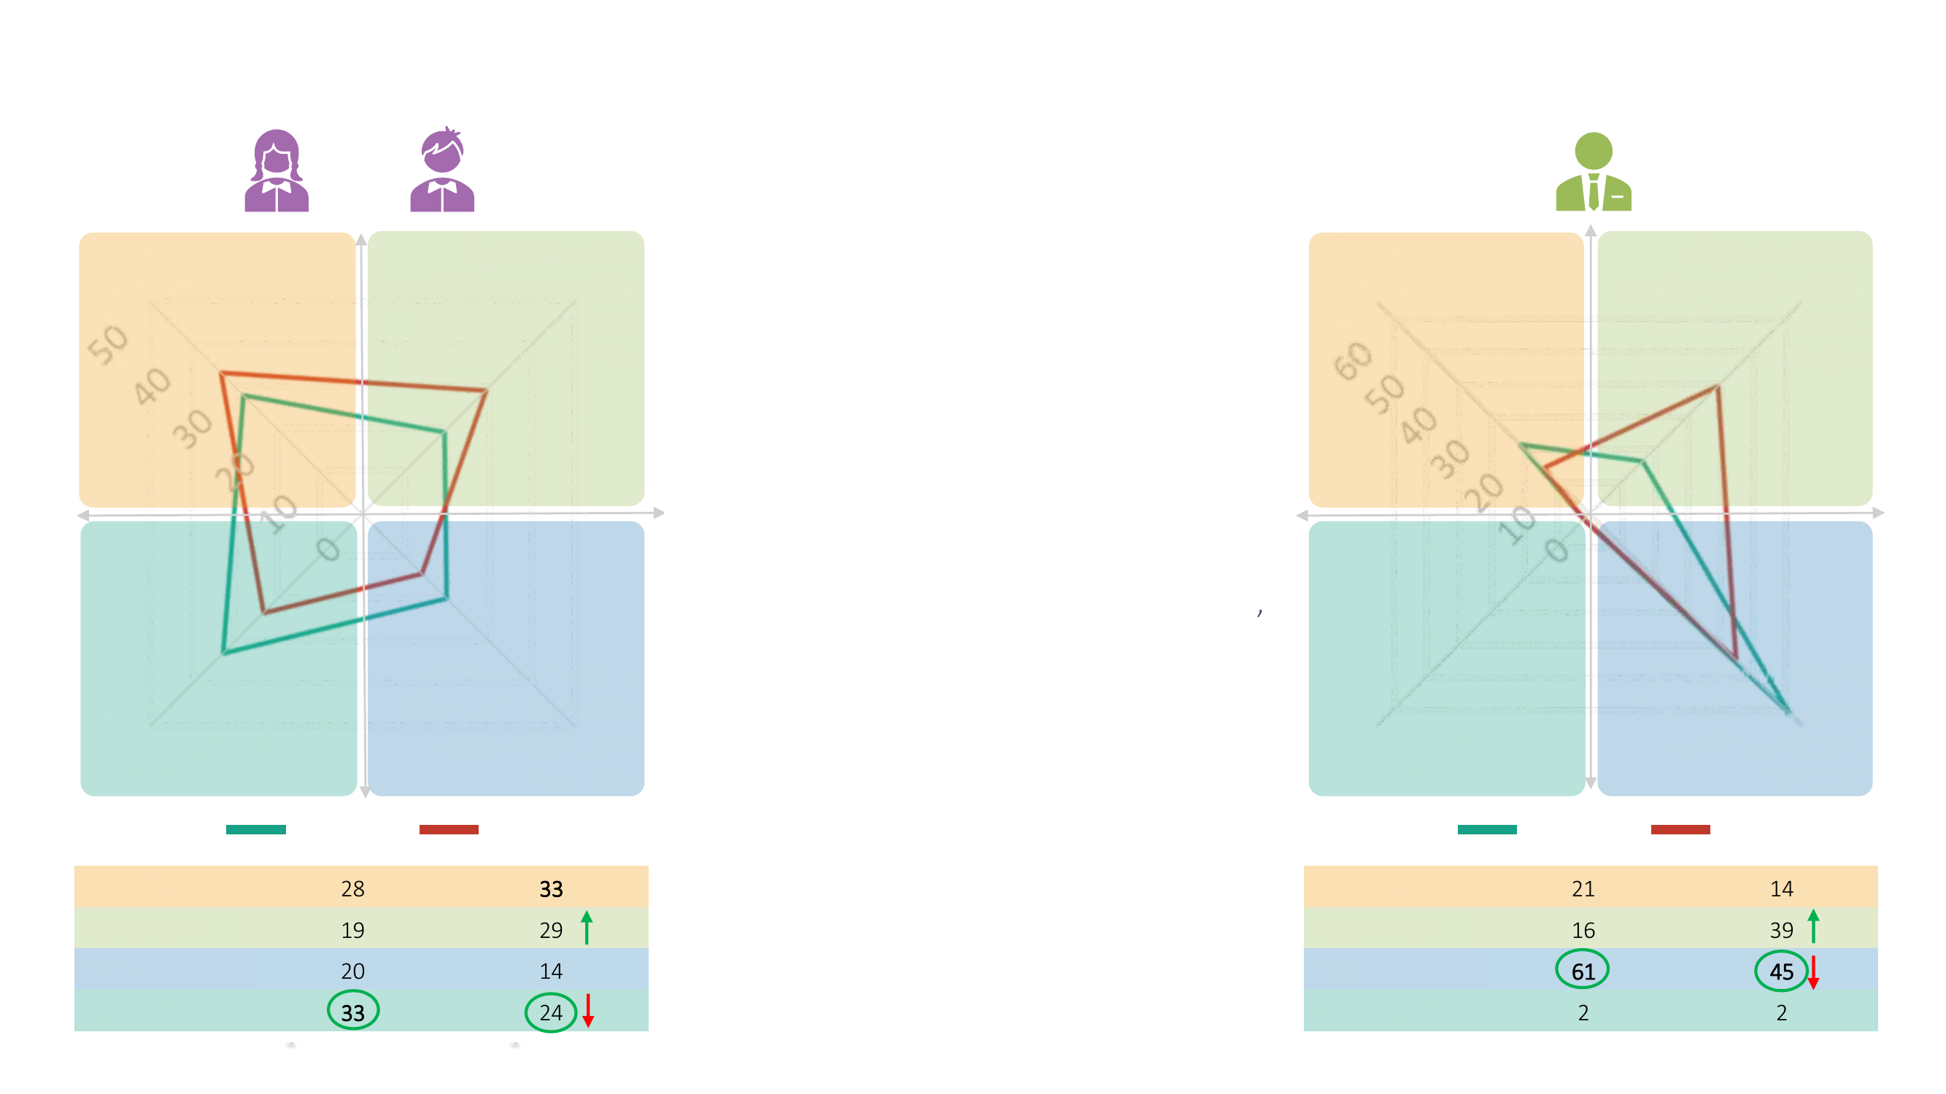
Assessing success
Gen Z
Company
representatives
Various qualitative team performance indicators​, engagement
Market success of a new product or service​, the ability to come up with something new.
Generation Z also wants to celebrate success more as a
Various qualitative team performance indicators​, engagement
Market success of a new product or service​, the ability to come up with something new.
team effort. They prefer qualitative success indicators –
engagement, as well as the ability to come up with something
new.
They clearly want to scale back the performance-based success indicators that dominate at their current job.
Here too they differ sharply from managers, who clearly prefer assessing
Financial KPI performance indicators​; market success is the key parameter
success by performance – where a
Financial KPI performance indicators​; market success is the key parameter
Per-unit performance indicators​, low costs, quality
product's/service's market success is the key parameter. But like young people, they too would like to be recognized more than they are today for being innovative.
Per-unit performance indicators​, low costs, quality
CURRENT CULTURE
PREFERRED CULTURE
CURRENT CULTURE
PREFERRED CULTURE
CLAN
CLAN
INNOVATIVE
INNOVATIVE
MARKET
Bold = highest number in the column Arrows = what they want to weaken/strengthen in the preferred culture versus the current one Circles = the biggest difference between Gen Z and company representatives
MARKET
HIERARCHICAL
HIERARCHICAL
21 / Corporate Culture
Base: young people who work
Base: all young people

Slide 22
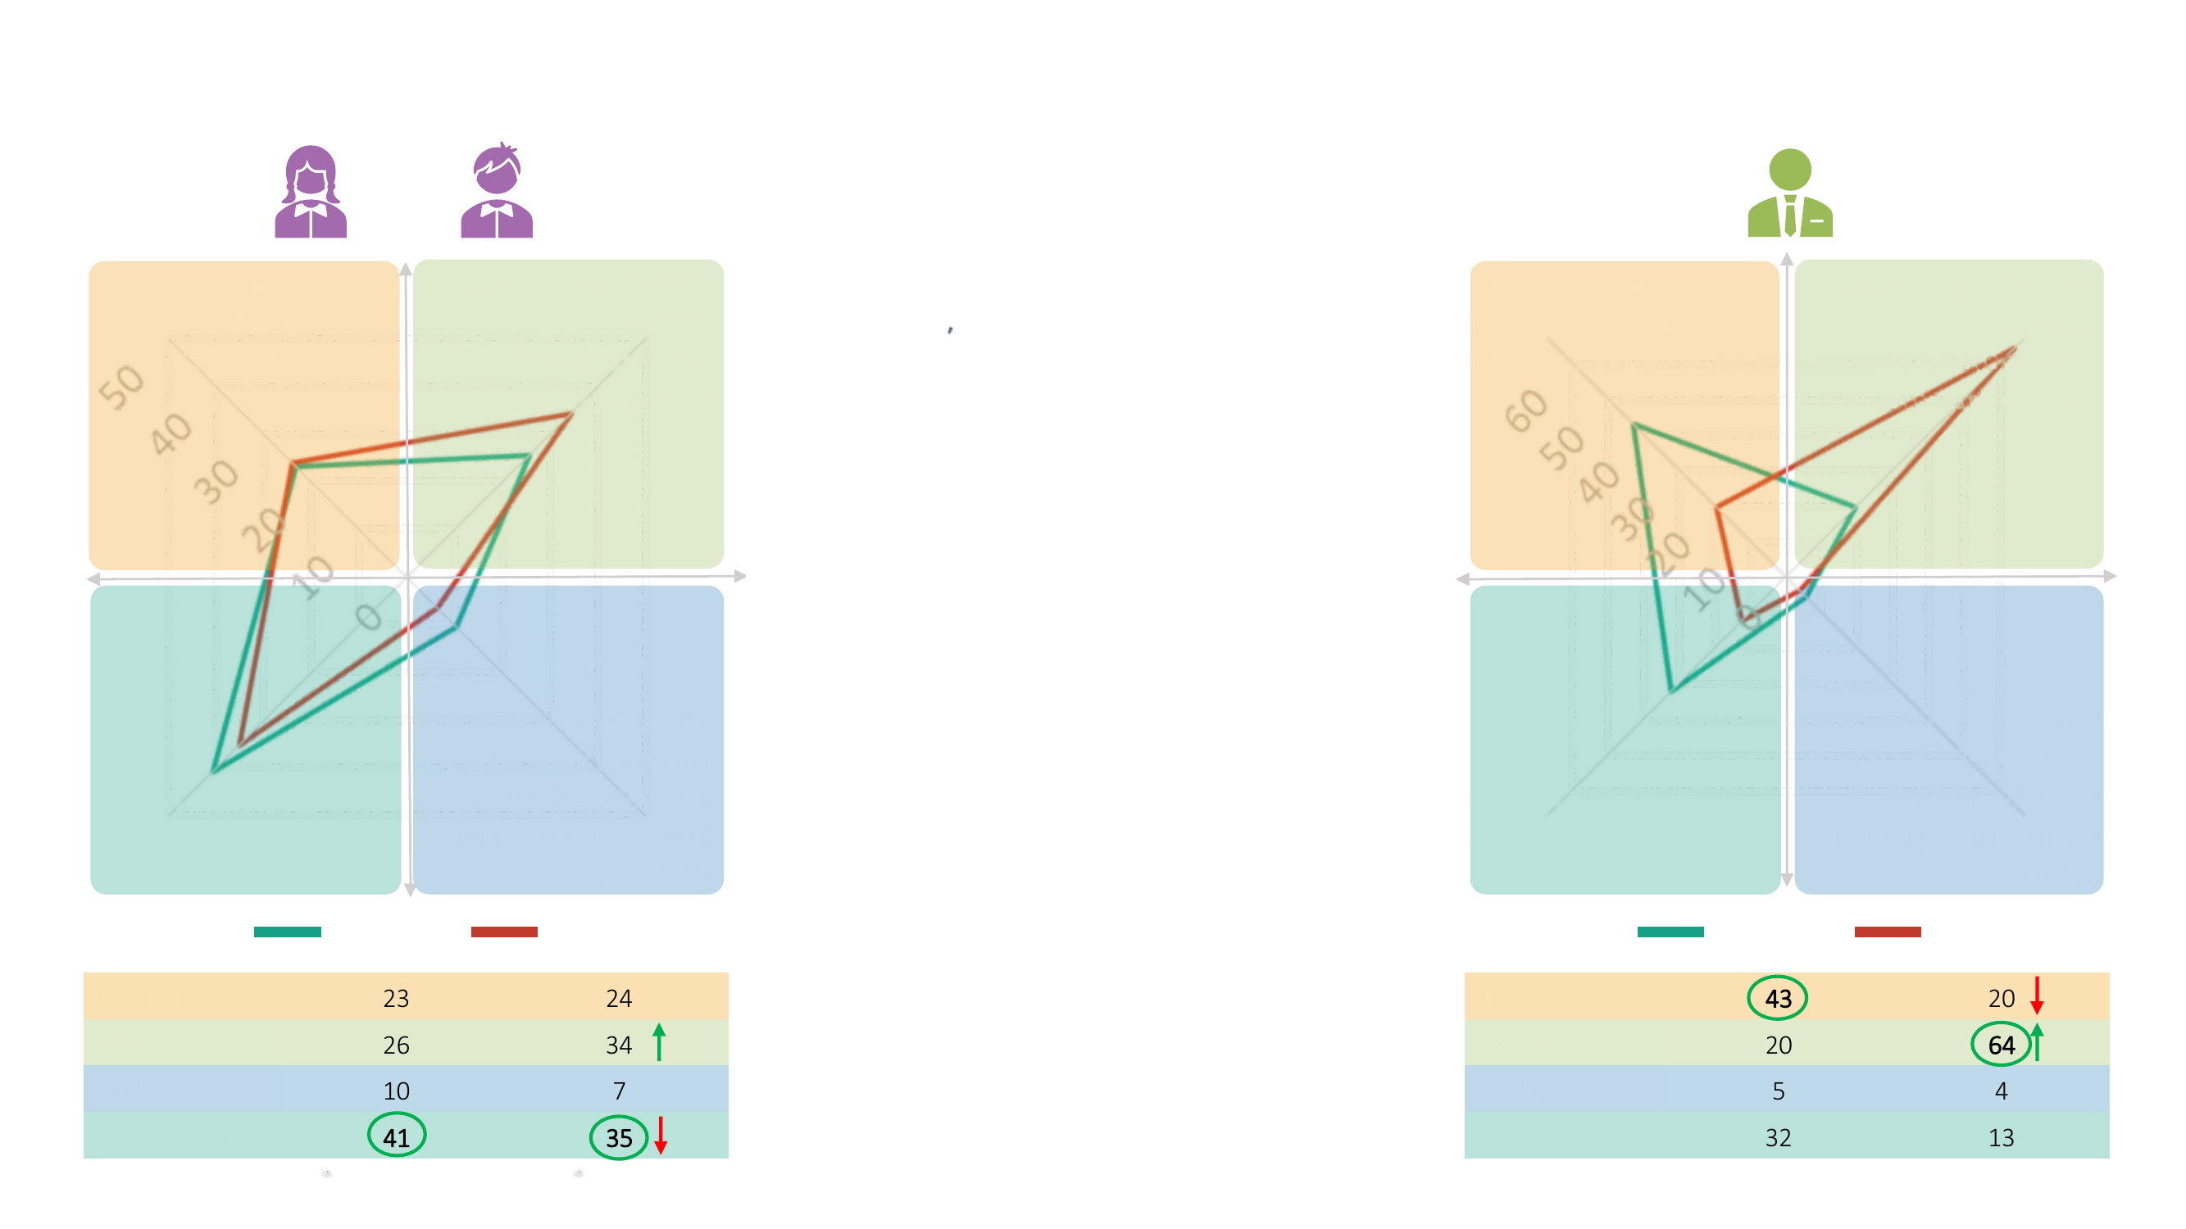
Rituals
Gen Z
Company
representatives
Team-building, long meetings, meetings with management
Emphasis on generating ideas, brainstorming, a friendly spirit​
Here too it's clear that young people want to place more emphasis on
Team-building, long meetings, meetings with management
Emphasis on generating ideas, brainstorming, a friendly spirit​
creativity, brainstorming, and generating
ideas – all in a friendly spirit.
At the same time, they don't mind gaining certain perks through these friendly, informal relationships.
On the first point (the emphasis on creativity) they agree with company representatives too; on the second (perks through informal relationships) they don't. Company representatives, for their part, would rather "talk less" (cut back on team-building, long meetings, and other meetings) and come up with more useful ideas.
A promotion is "an event." We celebrate successes, but we also sound the alarm when things aren't going well
A promotion is "an event." We celebrate successes, but we also sound the alarm when things aren't going well
Meetings, perks through informal relationships, rewards for loyalty
Meetings, perks through informal relationships, rewards for loyalty
CURRENT CULTURE
PREFERRED CULTURE
CURRENT CULTURE
PREFERRED CULTURE
CLAN
CLAN
INNOVATIVE
INNOVATIVE
MARKET
Bold = highest number in the column Arrows = what they want to weaken/strengthen in the preferred culture versus the current one Circles = the biggest difference between Gen Z and company representatives
MARKET
HIERARCHICAL
HIERARCHICAL
22 / Corporate Culture
Base: young people who work
Base: all young people

Slide 23
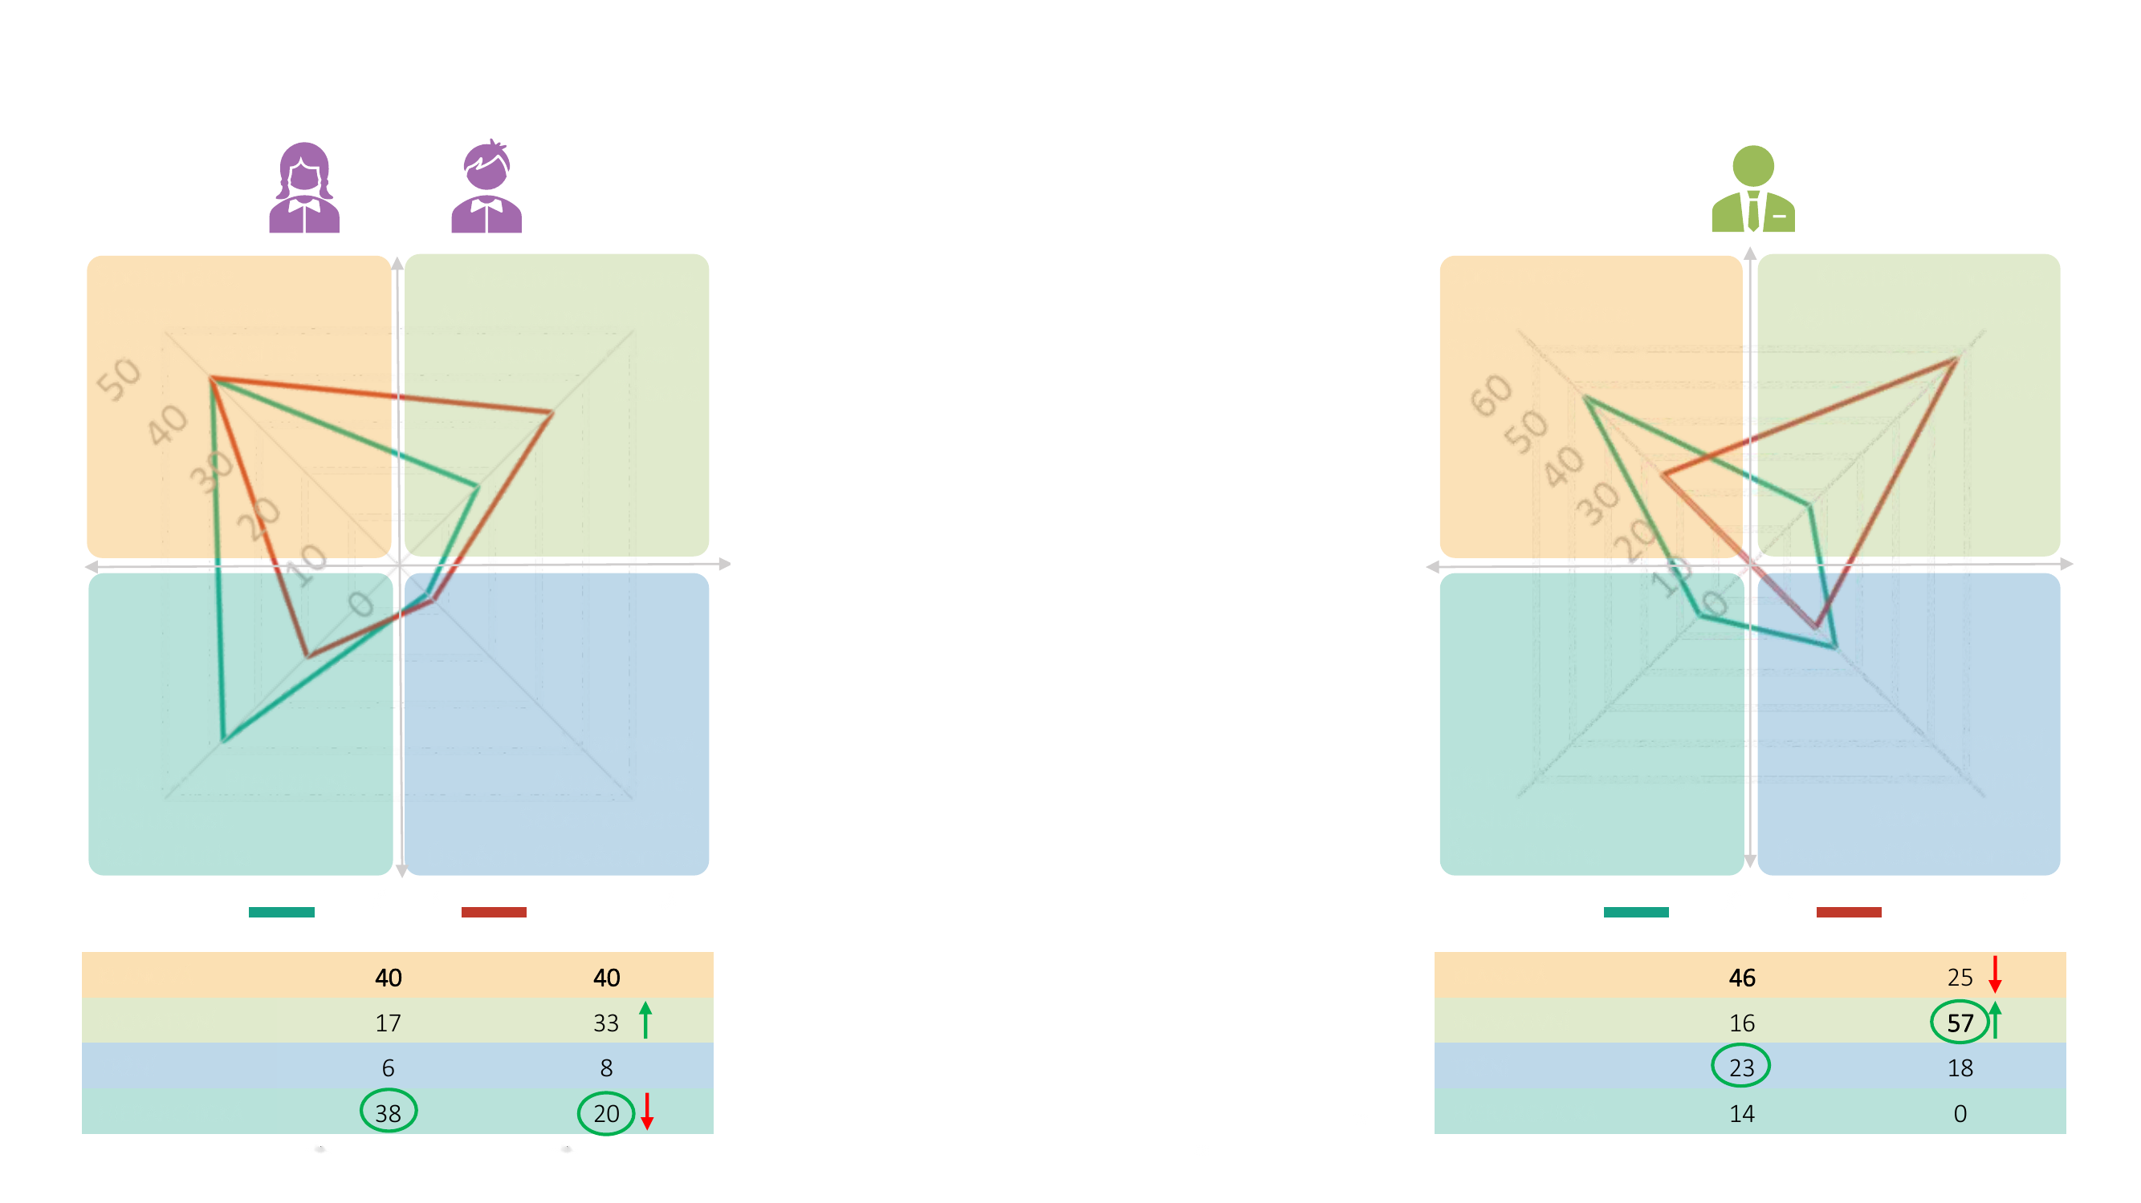
Values
Gen Z
Company
representatives
Collaboration, Security, Tradition, Stability, Loyalty​
Creativity, Innovation, Agility, Purpose, Freedom, Playfulness and Fun​
Don't throw tradition overboard. When it comes to company values, young people expect emphasis on
Collaboration, Security, Tradition, Stability, Loyalty​
Creativity, Innovation, Agility, Purpose, Freedom, Playfulness and Fun​
security, loyalty, and collaboration.
What's missing for them at their current jobs, though, is a greater emphasis on creativity, innovation, purpose, freedom, and playfulness.
Here they agree with managers, who want to place even more emphasis on innovation and creativity, specifically at the expense of the more conservative values of tradition and collaboration.
Mastery,
Mastery,
Efficiency, Precision, Obedience, Order and Routine
Autonomy,
Efficiency, Precision, Obedience, Order and Routine
Autonomy,
Self-motivation, Achievement​, Ambition
Self-motivation, Achievement​, Ambition
CURRENT CULTURE
PREFERRED CULTURE
CURRENT CULTURE
PREFERRED CULTURE
CLAN
CLAN
INNOVATIVE
INNOVATIVE
MARKET
Bold = highest number in the column Arrows = what they want to weaken/strengthen in the preferred culture versus the current one Circles = the biggest difference between Gen Z and company representatives
MARKET
HIERARCHICAL
HIERARCHICAL
23 / Corporate Culture
Base: young people who work
Base: all young people

Slide 24
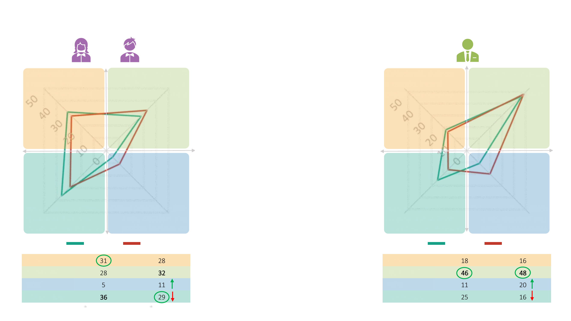
Myths and stories
Gen Z
Company
representatives
Founders, decency and respect, overcoming internal problems
Product or service successes on the market, top projects​
There's no need to celebrate only what's newest.
Founders, decency and respect, overcoming internal problems
Product or service successes on the market, top projects​
In young people's view, faithful service to the company, long-tenured employees, company founders, decency and respect, or the ability to be aligned with the company also deserve recognition. But they definitely don't want to celebrate individual success or beating the competition.
Their current job basically matches what they'd like here.
Today's managers are more pragmatic and mainly value the market success of services, products, or projects.
Being aligned with the company, faithful service to the company, long-tenured employees
Celebrating our top performers, achieving the dream, beating the competition​
Being aligned with the company, faithful service to the company, long-tenured employees
Celebrating our top performers, achieving the dream, beating the competition​
CURRENT CULTURE
PREFERRED CULTURE
CURRENT CULTURE
PREFERRED CULTURE
CLAN
CLAN
INNOVATIVE
INNOVATIVE
MARKET
Bold = highest number in the column Arrows = what they want to weaken/strengthen in the preferred culture versus the current one Circles = the biggest difference between Gen Z and company representatives
MARKET
HIERARCHICAL
HIERARCHICAL
24 / Corporate Culture
Base: young people who work
Base: all young people

Slide 25
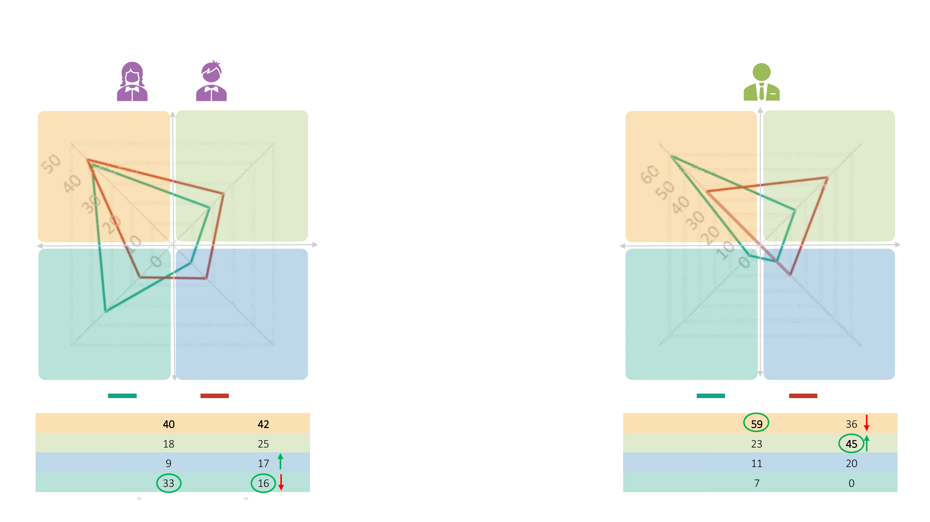
Physical traits
Gen Z
Company
representatives
A more relaxed dress code, open-plan space for staff, plenty of meeting rooms
A fully informal dress code, frequent work-from-home, leadership works alongside people and hosts joint parties
Having lived through the pandemic, young people no longer want to be home alone. They want to meet up with
A more relaxed dress code, open-plan space for staff, plenty of meeting rooms
A fully informal dress code, frequent work-from-home, leadership works alongside people and hosts joint parties
colleagues in open-plan spaces and in
meeting rooms. And they definitely prefer a more relaxed
dress code.
Compared with their current job, they'd like to drop the formal dress and strengthen team spirit, so that top management isn't separated from the rest of the company.
Whoever performs gets perks and better benefits; an informal but professional dress code
Whoever performs gets perks and better benefits; an informal but professional dress code
A prescribed formal dress code. Top management is separated from the rest of the company.​
Experienced managers have already had their fill of open-plan offices and instead prefer frequent work-from-home and joint company events with leadership.
A prescribed formal dress code. Top management is separated from the rest of the company.​
CURRENT CULTURE
PREFERRED CULTURE
CURRENT CULTURE
PREFERRED CULTURE
CLAN
CLAN
INNOVATIVE
INNOVATIVE
MARKET
Bold = highest number in the column Arrows = what they want to weaken/strengthen in the preferred culture versus the current one Circles = the biggest difference between Gen Z and company representatives
MARKET
HIERARCHICAL
HIERARCHICAL
25 / Corporate Culture
Base: young people who work
Base: all young people

Slide 26
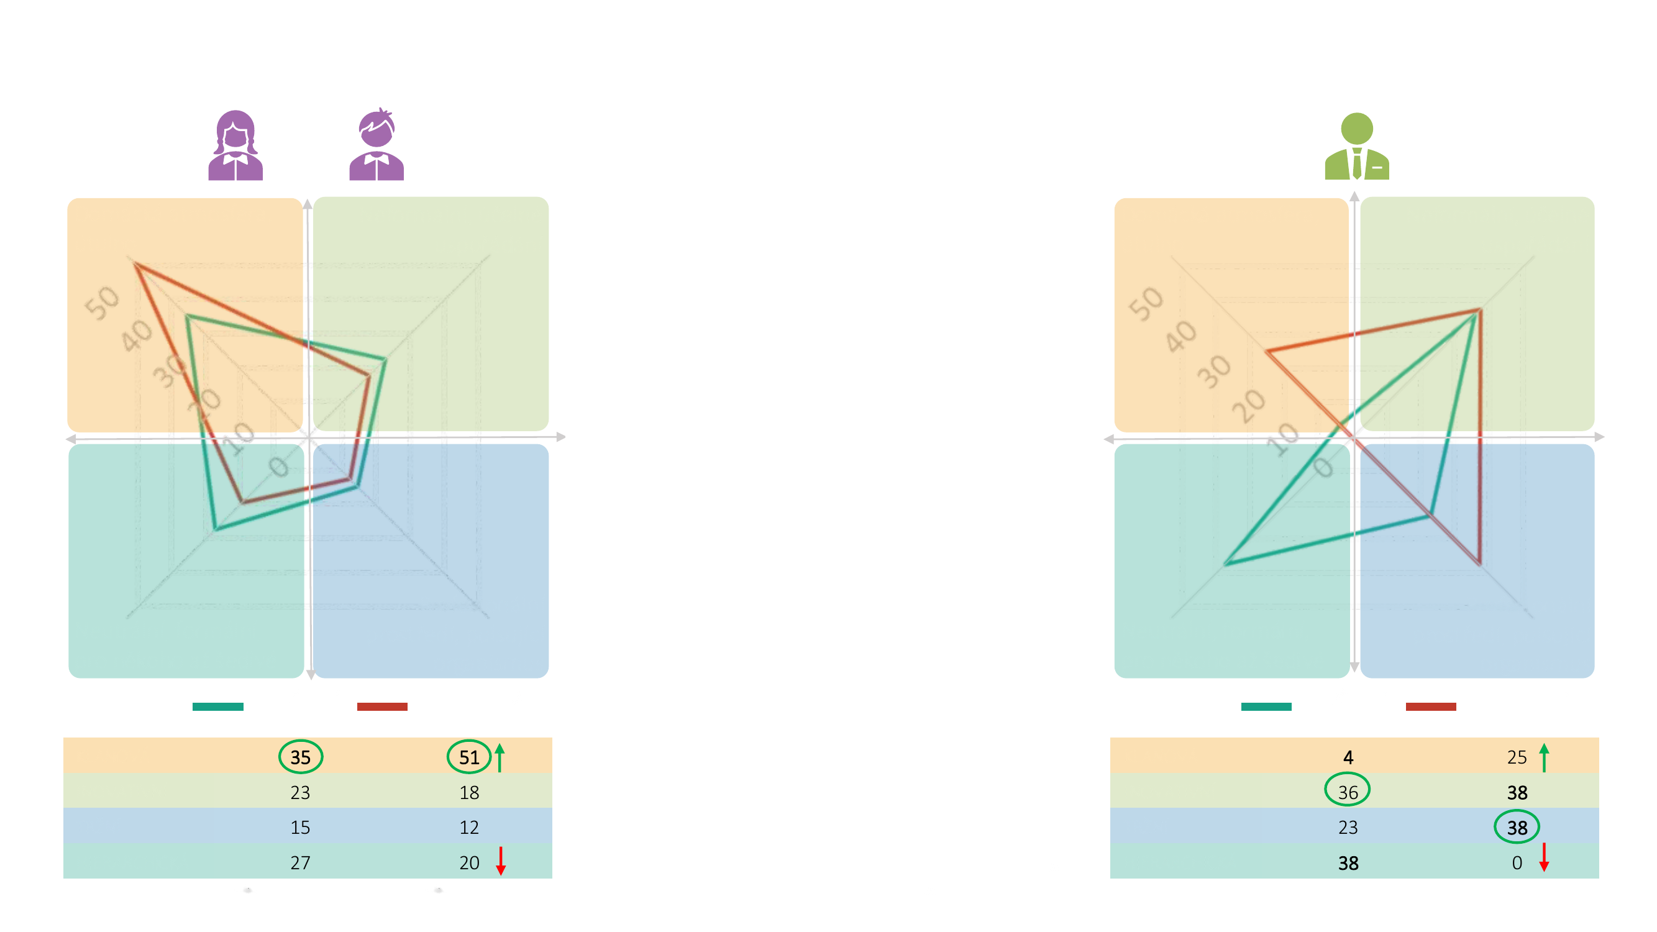
Workplace
Gen Z
Company
representatives
A homely atmosphere, cosiness
An informal, functional layout
Young people want a "cosy nest" – comfortable, cosy,
A homely atmosphere, cosiness
An informal, functional layout
and home-like. Their current workplaces are too formal, even drab.
Experienced managers prefer a professional and
functional layout of the space.
A professional environment, a buzzing organism
A professional environment, a buzzing organism
Neutral, formal, drab to some
Neutral, formal, drab to some
CURRENT CULTURE
PREFERRED CULTURE
CURRENT CULTURE
PREFERRED CULTURE
CLAN
CLAN
INNOVATIVE
INNOVATIVE
MARKET
Bold = highest number in the column Arrows = what they want to weaken/strengthen in the preferred culture versus the current one Circles = the biggest difference between Gen Z and company representatives
MARKET
HIERARCHICAL
HIERARCHICAL
26 / Corporate Culture
Base: young people who work
Base: all young people

Slide 27

Diagnosing Gen Z corporate culture: students vs. non-students
27 / Corporate Culture

Slide 28
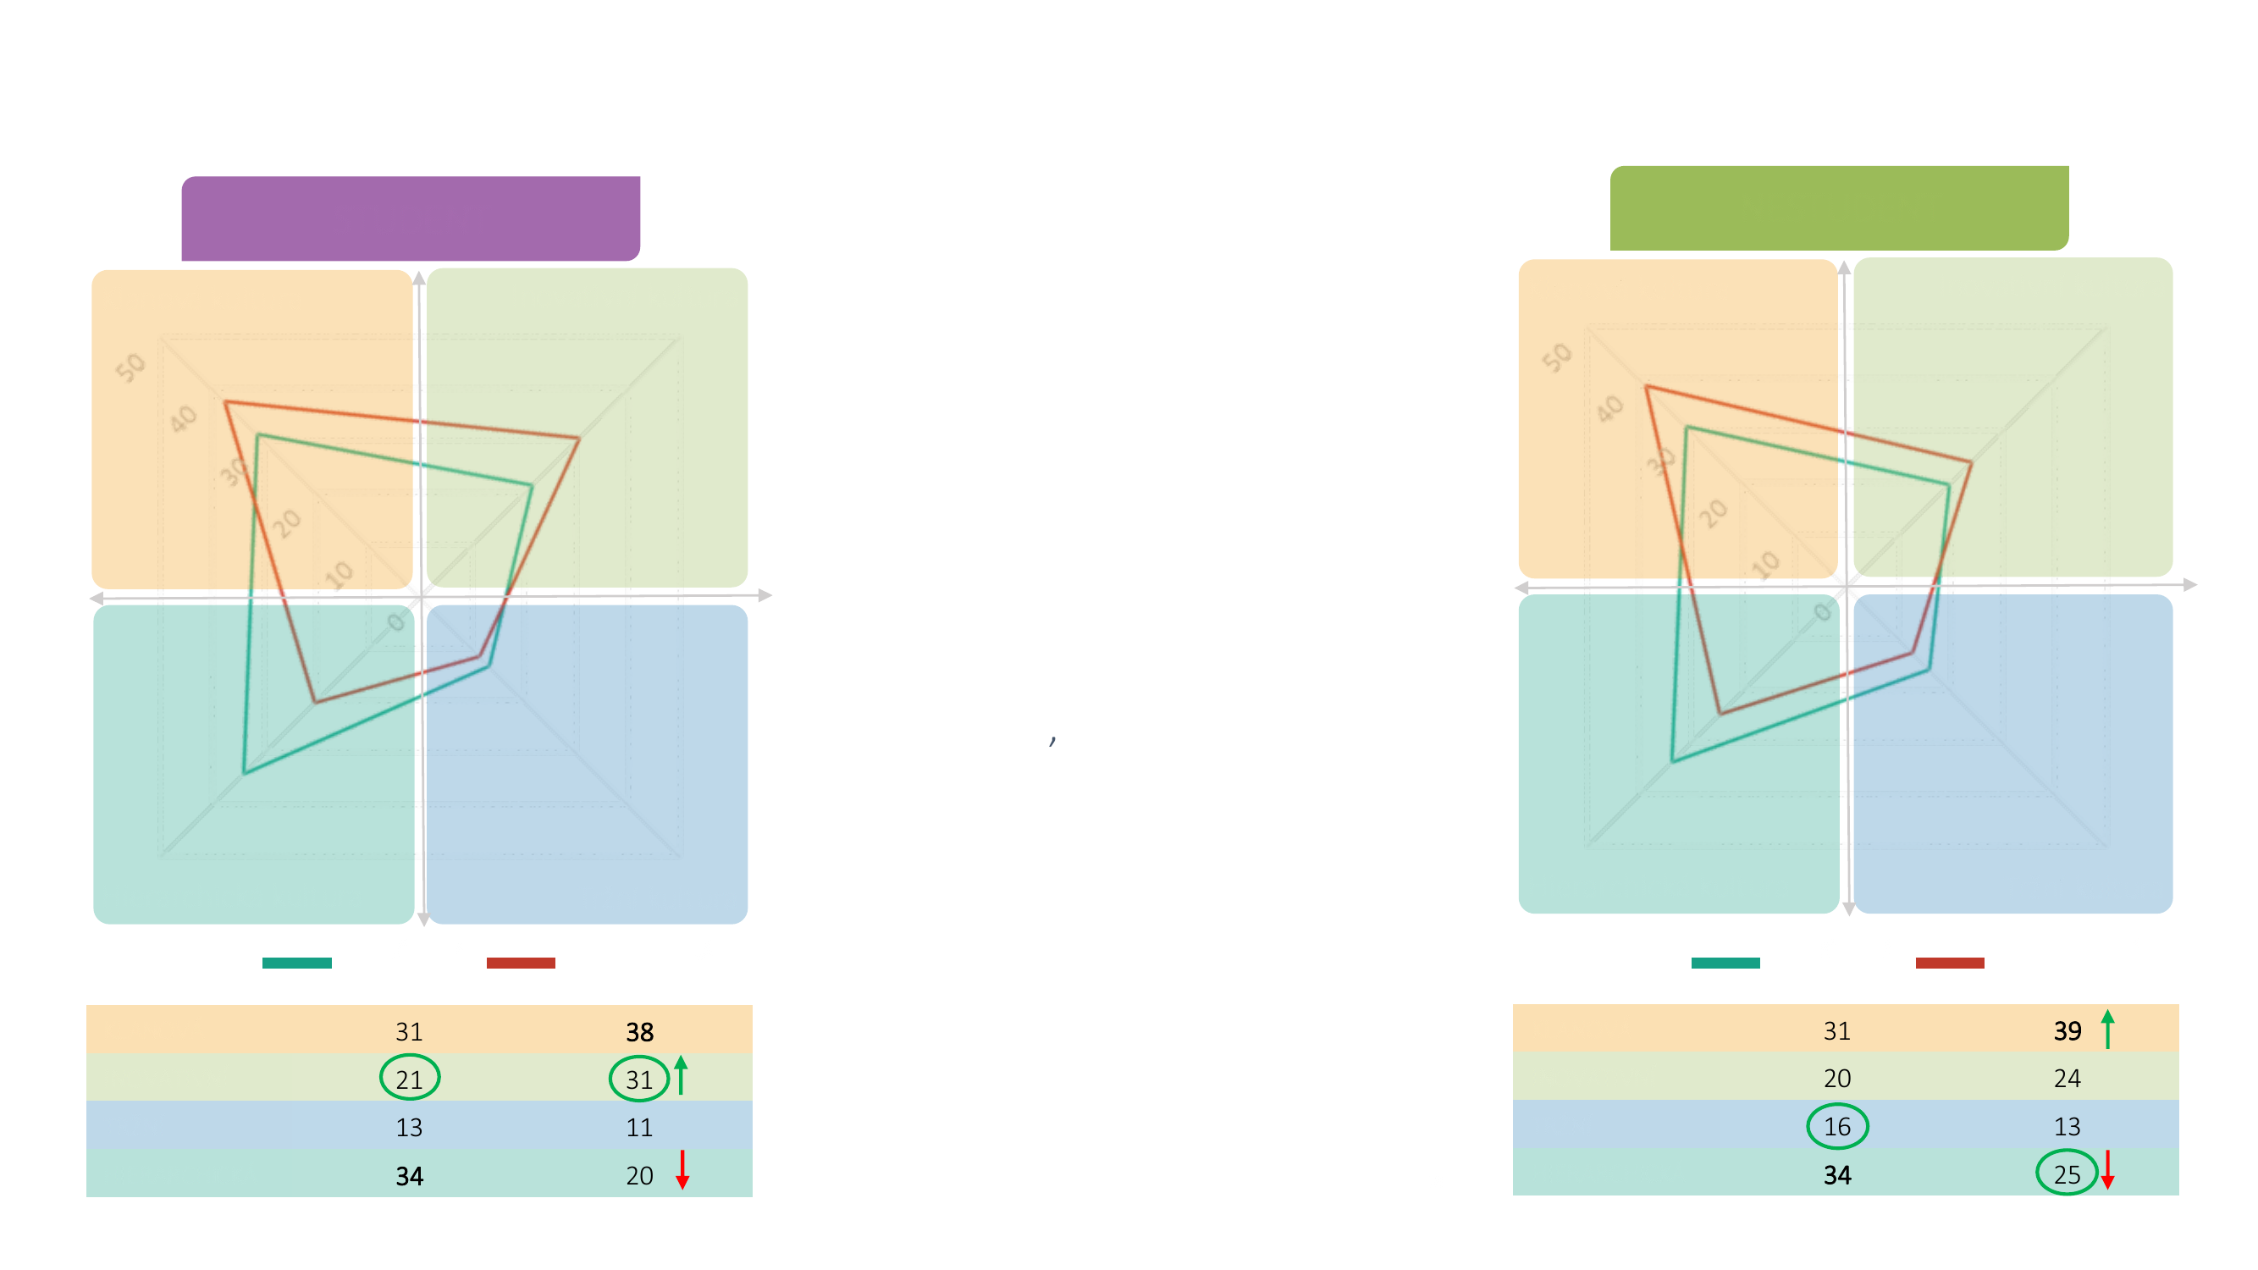
Corporate culture by student status
STUDENT
NON-STUDENT
Clan culture
Innovative culture
Clan culture
Innovative culture
Students' and non-students' views of corporate culture don't differ much. For both groups, clan culture is the most preferred.
On top of that, students would prefer
an innovative culture to a greater extent. Those who
aren't studying are more open to a hierarchical culture.
Hierarchical culture
Market culture
Hierarchical culture
Market culture
CURRENT CULTURE
PREFERRED CULTURE
CURRENT CULTURE
PREFERRED CULTURE
CLAN
CLAN
INNOVATIVE
INNOVATIVE
MARKET
Bold = highest number in the column Arrows = what they want to weaken/strengthen in the preferred culture versus the current one Circles = the biggest difference between students and non-students
MARKET
HIERARCHICAL
HIERARCHICAL
28 / Corporate Culture

Slide 29
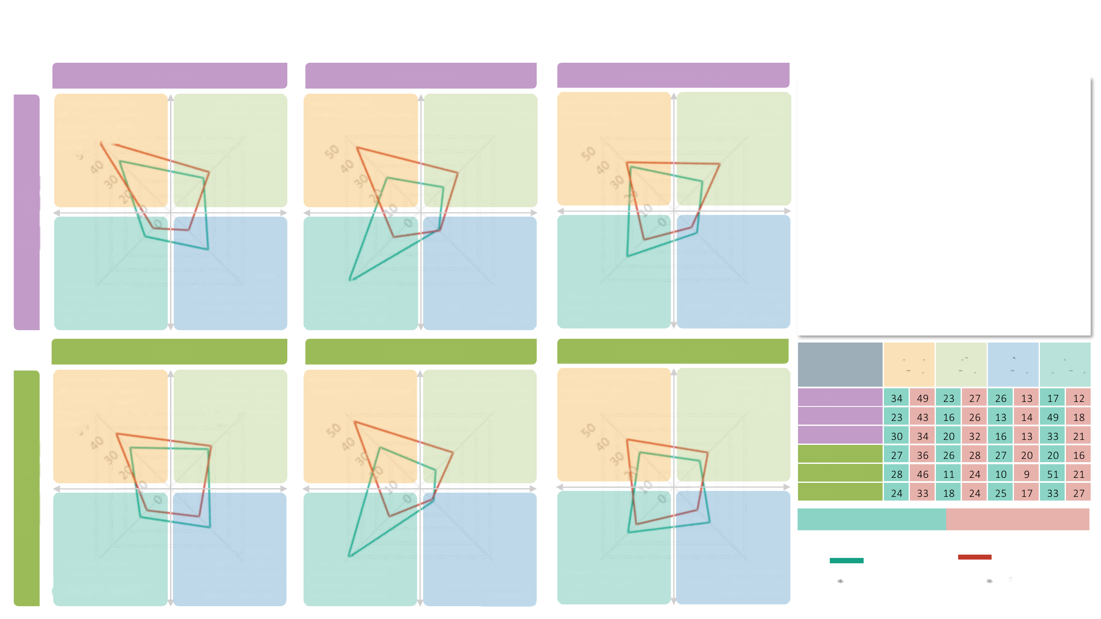
Corporate culture in detail I
LEADERSHIP
DECISION-MAKING
ASSESSING SUCCESS
Mentoring, passing on useful advice. Managers are easily accessible and have their own agenda
Help finding opportunities. Managers are right there in the team and share the same agenda as the rest of the team
More people involved, compromise, voting, and so on
Fast, calmly and intuitively, drawing on the expertise of team members
Various qualitative team performance indicators​, engagement
Market success of a new product or service​, the ability to come up with something new.
For both groups, clan culture is the most preferred. On decision-making, for example, everyone most often experiences a hierarchical culture – that is, decisions made by established practices. They would welcome more compromise and voting in decision-making, though. Students (certainly influenced by their study experience too) value mentoring even more, while non-students are more open to learning on the fly and to pressure to perform.
STUDENT
Primarily formal, based on positional authority. Managers are "further away" from people
Learning "on the fly," consistent pressure to perform, and leading by example​. Managers are among the people and set both the pace and the direction
In the hands of clearly designated managers; decisions follow established practices
Per-unit performance indicators​, low costs, quality
Financial KPI performance indicators​; market success is the key parameter
Based on data, rationally, driven by the market
LEADERSHIP
DECISION-MAKING
ASSESSING SUCCESS
Clan culture
Innovative culture
Market culture
Hierarchical culture
Mentoring, passing on useful advice. Managers are easily accessible and have their own agenda
Help finding opportunities. Managers are right there in the team and share the same agenda as the rest of the team
More people involved, compromise, voting, and so on
Fast, calmly and intuitively, drawing on the expertise of team members
Various qualitative team performance indicators​, engagement
Market success of a new product or service​, the ability to come up with something new.
LEADERSHIP
DECISION-MAKING
SUCCESS
LEADERSHIP
DECISION-MAKING
NON-STUDENT
SUCCESS
CURRENT CULTURE
PREFERRED CULTURE
Learning "on the fly," consistent pressure to perform, and leading by example​. Managers are among the people and set both the pace and the direction
CURRENT CULTURE
PREFERRED CULTURE
Primarily formal, based on positional authority. Managers are "further away" from people
In the hands of clearly designated managers; decisions follow established practices
Per-unit performance indicators​, low costs, quality
Financial KPI performance indicators​; market success is the key parameter
29 / Corporate Culture
Based on data, rationally, driven by the market
Base: young people who work
Base: all young people

Slide 30
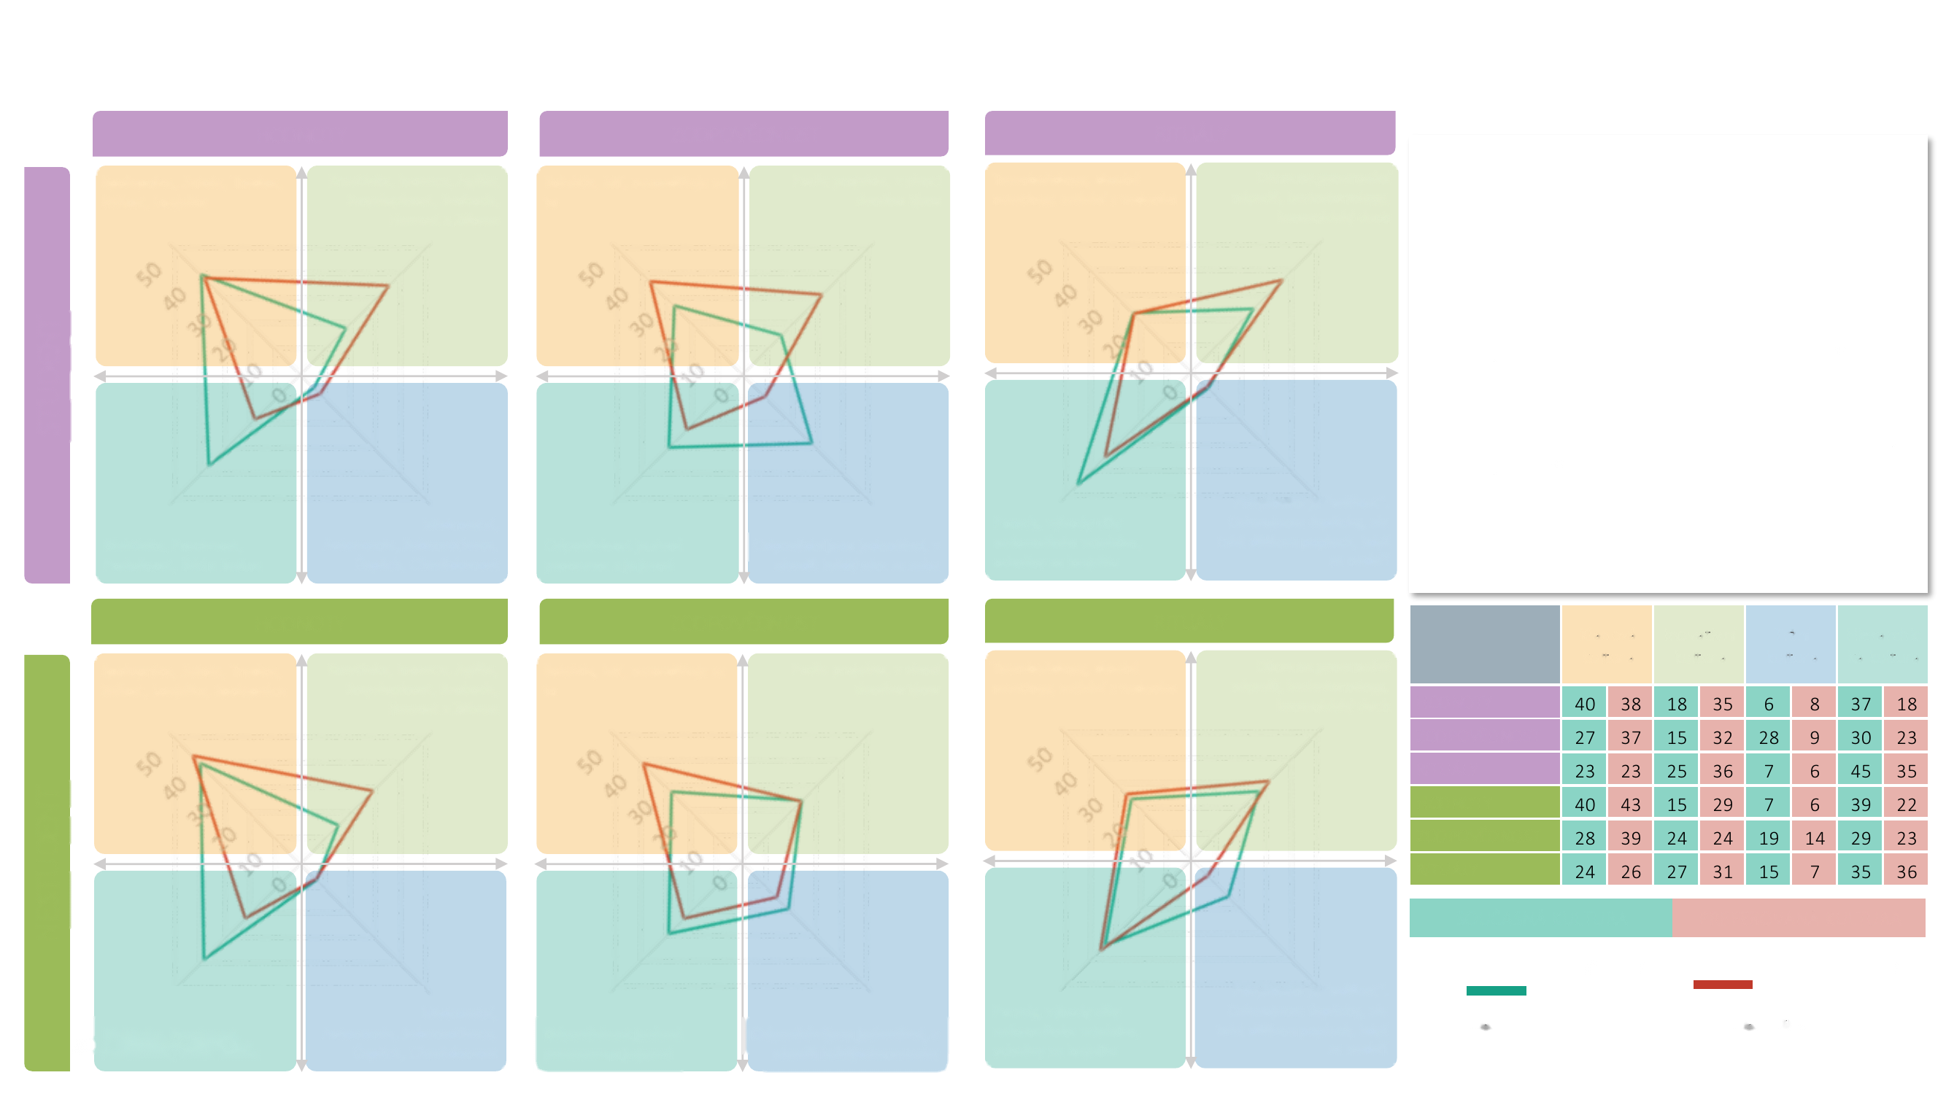
Corporate culture in detail II
VALUES
ACCOUNTABILITY
RITUALS
Collaboration, Security, Tradition, Stability, Loyalty​
Creativity, Innovation, Agility, Purpose, Freedom, Playfulness and Fun​
The group, WE, it isn't divided up
By project, within the given team
Team-building, long meetings, meetings with management
Emphasis on generating ideas, brainstorming, a friendly spirit​
Both groups rate the current and preferred corporate culture similarly. Students are slightly more open to an innovative culture, particularly regarding accountability (by project, within the given team). Non-students prefer clan culture even more, particularly regarding values (collaboration, security, tradition, stability, loyalty).
STUDENT
Meetings, perks through informal relationships, rewards for loyalty
A promotion is "an event." We celebrate successes, but we also sound the alarm when things aren't going well
Efficiency, Precision, Obedience, Order and Routine
Mastery, Autonomy, Self-motivation, Achievement​, Ambition
Accountability is defined by the process and is clear
Individuals are accountable; basically, everyone for themselves
VALUES
ACCOUNTABILITY
RITUALS
Clan culture
Innovative culture
Market culture
Hierarchical culture
Collaboration, Security, Tradition, Stability, Loyalty, Collaboration​
Creativity, Innovation, Agility, Purpose, Freedom, Playfulness and Fun​
The group, WE, it isn't divided up
By project, within the given team
Team-building, long meetings, meetings with management
Emphasis on generating ideas, brainstorming, a friendly spirit​
VALUES
ACCOUNTABILITY
RITUALS
VALUES
ACCOUNTABILITY
NON-STUDENT
RITUALS
CURRENT CULTURE
PREFERRED CULTURE
CURRENT CULTURE
PREFERRED CULTURE
Meetings, perks through informal relationships, rewards for loyalty
A promotion is "an event." We celebrate successes, but we also sound the alarm when things aren't going well
Efficiency, Precision, Obedience, Order and Routine
Mastery, Autonomy, Self-motivation, Achievement​, Ambition
Accountability is defined by the process and is clear
Individuals are accountable; basically, everyone for themselves
Base: young people who work
Base: all young people
30 / Corporate Culture

Slide 31
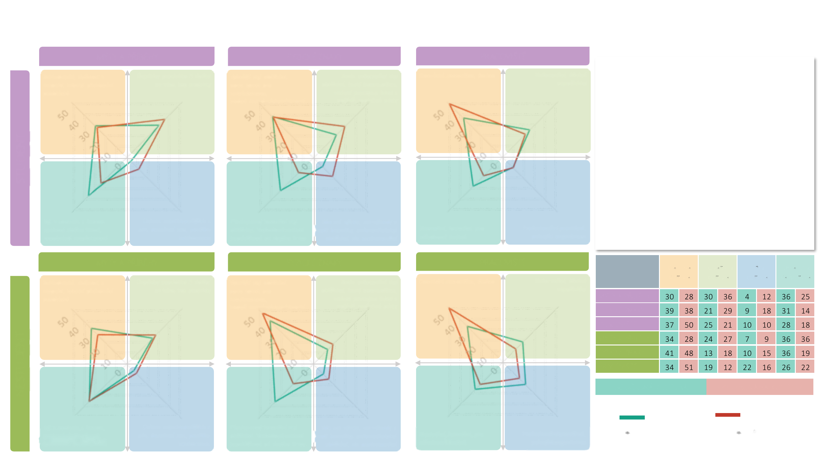
Corporate culture in detail III
MYTHS AND STORIES
PHYSICAL TRAITS
WORKPLACE
Founders, decency and respect, overcoming internal problems
Product or service successes on the market, top projects​
A more relaxed dress code, open-plan space for staff, plenty of meeting rooms
A fully informal dress code, frequent work-from-home, leadership works alongside people and hosts joint parties
A homely atmosphere, cosiness
An informal, functional layout
Both groups rate the current and preferred corporate culture similarly. Students are more open to an innovative culture, particularly regarding informal dress, the work environment, and celebrating top projects on the market. Non-students prefer a more relaxed dress code and open-plan space even more, but they also place greater emphasis on loyalty to the company (hierarchical culture).
STUDENT
Being aligned with the company, faithful service to the company, long-tenured employees
Celebrating our top performers, achieving the dream, beating the competition​
A prescribed formal dress code. Top management is separated from the rest of the company.​
Whoever performs gets perks and better benefits; an informal but professional dress code
Neutral, formal, drab to some
A professional environment, a buzzing organism
MYTHS AND STORIES
PHYSICAL TRAITS
WORKPLACE
Clan culture
Innovative culture
Market culture
Hierarchical culture
Founders, decency and respect, overcoming internal problems
Product or service successes on the market, top projects​
A more relaxed dress code, open-plan space for staff, plenty of meeting rooms
A fully informal dress code, frequent work-from-home, leadership works alongside people and hosts joint parties
A homely atmosphere, cosiness
An informal, functional layout
MYTHS AND STORIES
PHYSICAL TRAITS
WORKPLACE
MYTHS AND STORIES
PHYSICAL TRAITS
NON-STUDENT
WORKPLACE
CURRENT CULTURE
PREFERRED CULTURE
CURRENT CULTURE
PREFERRED CULTURE
Being aligned with the company, faithful service to the company,
Celebrating our top performers, achieving the dream, beating the competition​
A prescribed formal dress code. Top management is separated from the rest of the company.​
Whoever performs gets perks and better benefits; an informal but professional dress code
Neutral, formal, drab to some
A professional environment, a buzzing organism
Base: young people who work
Base: all young people
31 / Corporate Culture
long-tenured employees

Slide 32

Diagnosing Gen Z corporate culture: employed vs. not employed
32 / Corporate Culture

Slide 33
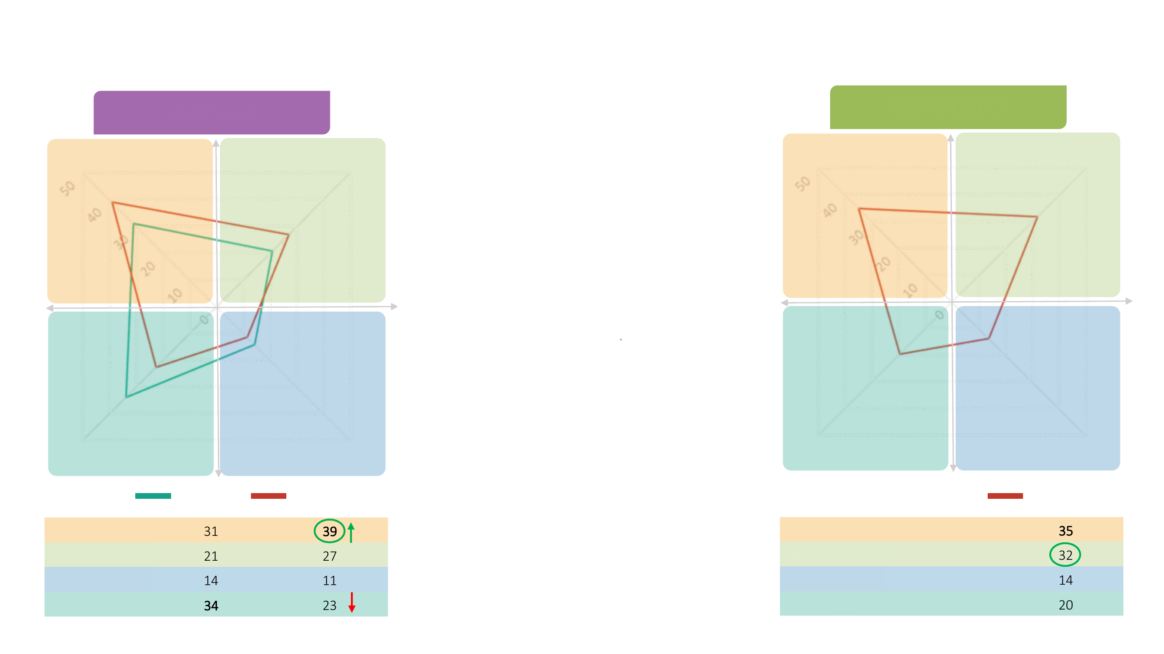
Gen Z: Corporate culture by employment status
EMPLOYED
NOT EMPLOYED
Clan culture
Innovative culture
Clan culture
Innovative culture
The preferred culture is similar among employed and non-employed young people. For both groups, clan culture is the most preferred option – among
those employed, even more so. Those not employed
lean a little more toward an innovative culture.
Hierarchical culture
Market culture
Hierarchical culture
Market culture
CURRENT CULTURE
PREFERRED CULTURE
PREFERRED CULTURE
CLAN
CLAN
INNOVATIVE
INNOVATIVE
MARKET
Bold = highest number in the column Arrows = what they want to weaken/strengthen in the preferred culture versus the current one Circles = the biggest difference between those employed and those not employed
MARKET
HIERARCHICAL
HIERARCHICAL
33 / Corporate Culture

Slide 34
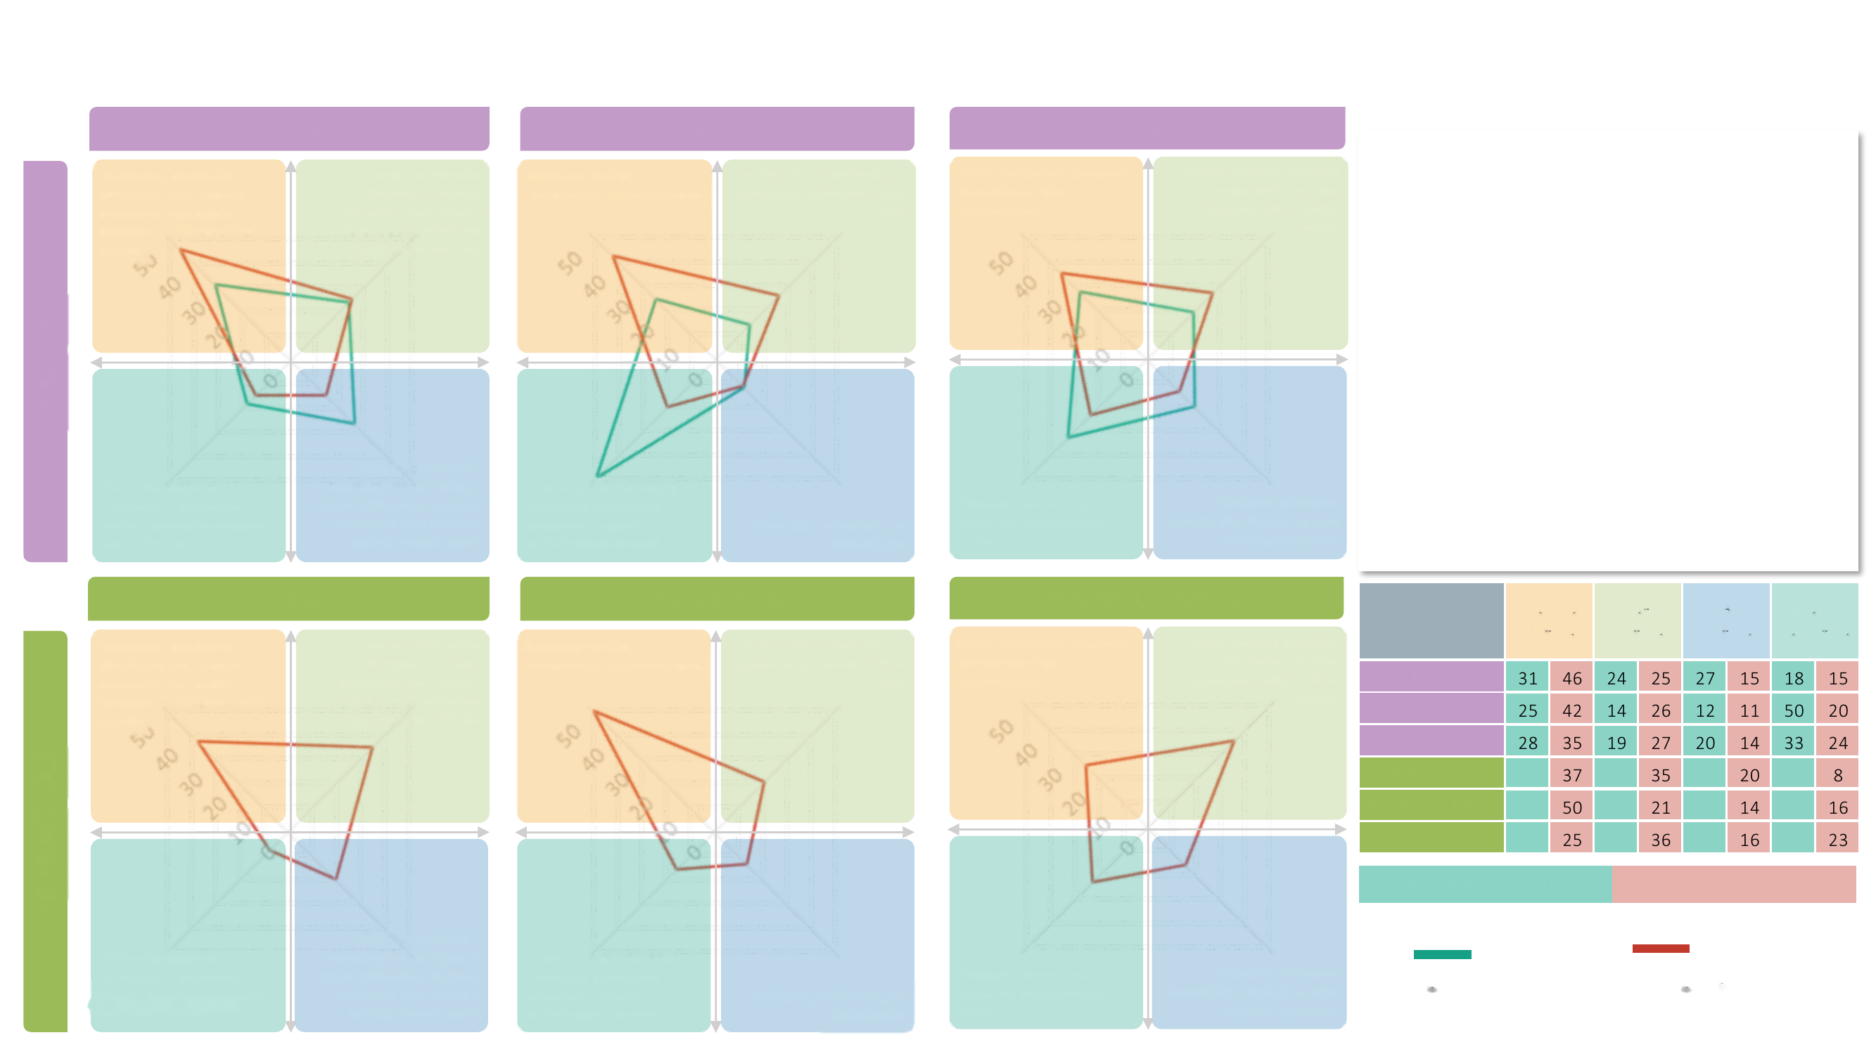
Corporate culture in detail I
LEADERSHIP
DECISION-MAKING
ASSESSING SUCCESS
Mentoring, passing on useful advice. Managers are easily accessible and have their own agenda
Help finding opportunities. Managers are right there in the team and share the same agenda as the rest of the team
More people involved, compromise, voting, and so on
Fast, calmly and intuitively, drawing on the expertise of team members
Various qualitative team performance indicators​, engagement
Market success of a new product or service​, the ability to come up with something new.
Those who work prefer clan culture the most. Those not working do too, for the most part, but they also lean more toward an innovative culture.
EMPLOYED
Primarily formal, based on positional authority. Managers are "further away" from people
Learning "on the fly," consistent pressure to perform, and leading by example​. Managers are among the people and set both the pace and the direction
In the hands of clearly designated managers; decisions follow established practices
Per-unit performance indicators​, low costs, quality
Financial KPI performance indicators​; market success is the key parameter
Based on data, rationally, driven by the market
LEADERSHIP
DECISION-MAKING
ASSESSING SUCCESS
Clan culture
Innovative culture
Market culture
Hierarchical culture
Mentoring, passing on useful advice. Managers are easily accessible and have their own agenda
Help finding opportunities. Managers are right there in the team and share the same agenda as the rest of the team
More people involved, compromise, voting, and so on
Fast, calmly and intuitively, drawing on the expertise of team members
Various qualitative team performance indicators​, engagement
Market success of a new product or service​, the ability to come up with something new.
LEADERSHIP
DECISION-MAKING
SUCCESS
LEADERSHIP
DECISION-MAKING
NOT EMPLOYED
SUCCESS
CURRENT CULTURE
PREFERRED CULTURE
Learning "on the fly," consistent pressure to perform, and leading by example​. Managers are among the people and set both the pace and the direction
CURRENT CULTURE
PREFERRED CULTURE
Primarily formal, based on positional authority. Managers are "further away" from people
In the hands of clearly designated managers; decisions follow established practices
Per-unit performance indicators​, low costs, quality
Financial KPI performance indicators​; market success is the key parameter
34 / Corporate Culture
Based on data, rationally, driven by the market
Base: young people who work
Base: all young people

Slide 35

Corporate culture in detail II
VALUES
ACCOUNTABILITY
RITUALS
Collaboration, Security, Tradition, Stability, Loyalty​
Creativity, Innovation, Agility, Purpose, Freedom, Playfulness and Fun​
The group, WE, it isn't divided up
By project, within the given team
Team-building, long meetings, meetings with management
Emphasis on generating ideas, brainstorming, a friendly spirit​
Employed young people prefer collective accountability, informal perks, and valuing loyalty and collaboration. Non-employed young people place a bit more value on creativity, innovation, brainstorming, and accountability within the given team. But even for them, a preference for clan values prevails.
EMPLOYED
Meetings, perks through informal relationships, rewards for loyalty
A promotion is "an event." We celebrate successes, but we also sound the alarm when things aren't going well
Efficiency, Precision, Obedience, Order and Routine
Mastery, Autonomy, Self-motivation, Achievement​, Ambition
Accountability is defined by the process and is clear
Individuals are accountable; basically, everyone for themselves
VALUES
ACCOUNTABILITY
RITUALS
Clan culture
Innovative culture
Market culture
Hierarchical culture
Collaboration, Security, Tradition, Stability, Loyalty, Collaboration​
Creativity, Innovation, Agility, Purpose, Freedom, Playfulness and Fun​
The group, WE, it isn't divided up
By project, within the given team
Team-building, long meetings, meetings with management
Emphasis on generating ideas, brainstorming, a friendly spirit​
VALUES
ACCOUNTABILITY
RITUALS
VALUES
ACCOUNTABILITY
NOT EMPLOYED
RITUALS
CURRENT CULTURE
PREFERRED CULTURE
CURRENT CULTURE
PREFERRED CULTURE
Meetings, perks through informal relationships, rewards for loyalty
A promotion is "an event." We celebrate successes, but we also sound the alarm when things aren't going well
Efficiency, Precision, Obedience, Order and Routine
Mastery, Autonomy, Self-motivation, Achievement​, Ambition
Accountability is defined by the process and is clear
Individuals are accountable; basically, everyone for themselves
Base: young people who work
Base: all young people
35 / Corporate Culture

Slide 36

Corporate culture in detail III
MYTHS AND STORIES
PHYSICAL TRAITS
WORKPLACE
Founders, decency and respect, overcoming internal problems
Product or service successes on the market, top projects​
A more relaxed dress code, open-plan space for staff, plenty of meeting rooms
A fully informal dress code, frequent work-from-home, leadership works alongside people and hosts joint parties
A homely atmosphere, cosiness
An informal, functional layout
Both groups of young people prefer open-plan space, a relaxed dress code, and a homely atmosphere. Among employed young people this preference is even stronger, while non-employed young people place a bit more emphasis on an informal style and celebrating top projects on the market.
EMPLOYED
Being aligned with the company, faithful service to the company, long-tenured employees
Celebrating our top performers, achieving the dream, beating the competition​
A prescribed formal dress code. Top management is separated from the rest of the company.​
Whoever performs gets perks and better benefits; an informal but professional dress code
Neutral, formal, drab to some
A professional environment, a buzzing organism
MYTHS AND STORIES
PHYSICAL TRAITS
WORKPLACE
Clan culture
Innovative culture
Market culture
Hierarchical culture
Founders, decency and respect, overcoming internal problems
Product or service successes on the market, top projects​
A more relaxed dress code, open-plan space for staff, plenty of meeting rooms
A fully informal dress code, frequent work-from-home, leadership works alongside people and hosts joint parties
A homely atmosphere, cosiness
An informal, functional layout
MYTHS AND STORIES
PHYSICAL TRAITS
WORKPLACE
MYTHS AND STORIES
PHYSICAL TRAITS
NOT EMPLOYED
WORKPLACE
CURRENT CULTURE
PREFERRED CULTURE
CURRENT CULTURE
PREFERRED CULTURE
Being aligned with the company, faithful service to the company,
Celebrating our top performers, achieving the dream, beating the competition​
A prescribed formal dress code. Top management is separated from the rest of the company.​
Whoever performs gets perks and better benefits; an informal but professional dress code
Neutral, formal, drab to some
A professional environment, a buzzing organism
Base: young people who work
Base: all young people
36 / Corporate Culture
long-tenured employees

Slide 37

Rating the employer/company by its dominant culture
37 / Corporate Culture

Slide 38
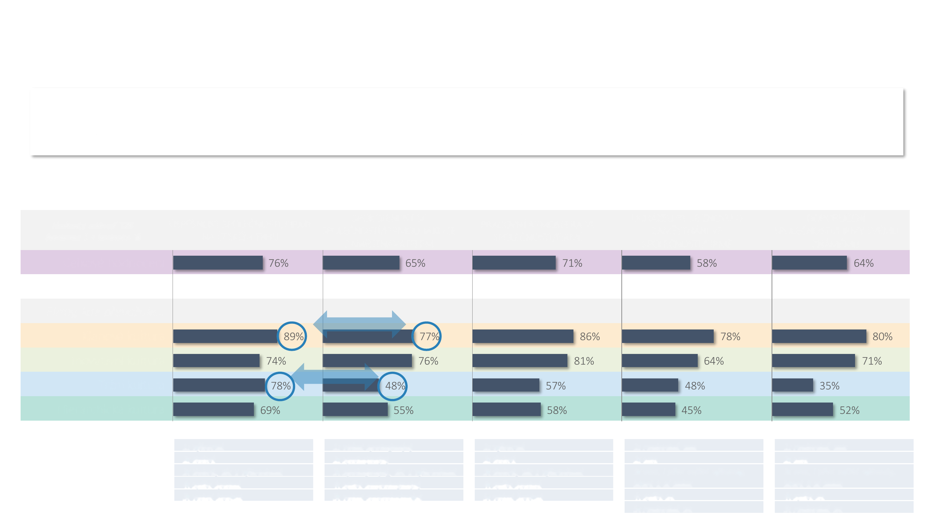
Company rating
The clan type of culture comes out best in the ratings, which is typical of Czech companies. Note that while market culture generates the lowest satisfaction and the lowest willingness to recommend, it produces the second-highest "perceived" success on the market.
Values represent T2B (rating 1 + rating 2)
THE COMPANY'S SUCCESS ON THE CZECH MARKET
SATISFACTION WITH THE COMPANY AS AN EMPLOYER
WORK ATMOSPHERE AT THE COMPANY
WOULD APPLY FOR A JOB AT THE COMPANY AGAIN
WOULD RECOMMEND THE COMPANY TO A FRIEND
Overall rating
Companies where the dominant culture is…
Clan culture
Innovative culture
Market culture
Hierarchical culture
1: excellent 2: good 3: good, but with reservations 4: rather poor 5: very poor
1: very satisfied 2: satisfied 3: satisfied, but with reservations 4: rather dissatisfied 5: very dissatisfied
1: excellent 2: good 3: good, but with reservations 4: rather poor 5: very poor
1: definitely yes 2: yes 3: yes, despite certain reservations I have 4: rather not 5: definitely not
1: definitely yes 2: yes 3: yes, despite certain reservations I have 4: rather not 5: definitely not
38 / Corporate Culture

Slide 39

Sample Description
39 / Corporate Culture

Slide 40
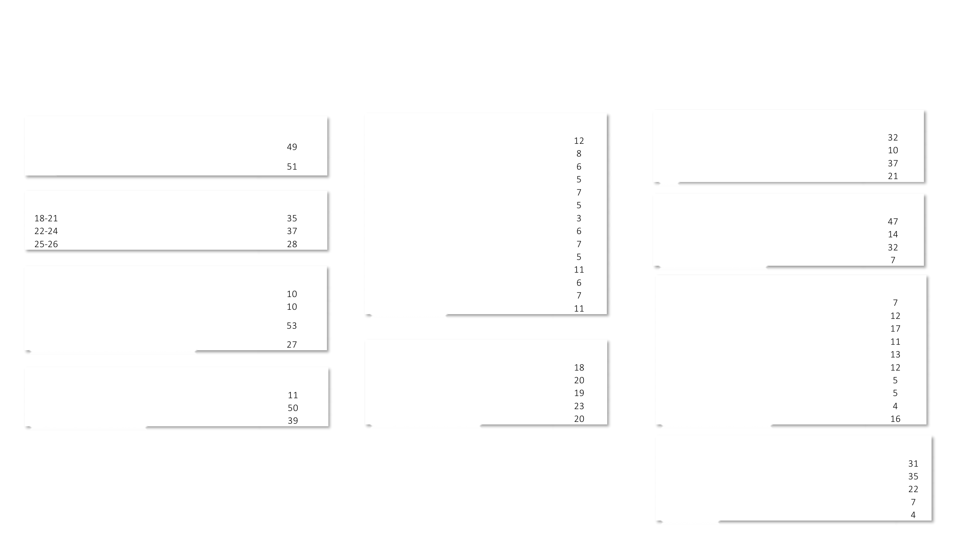
Description of the youth sample
N=300
Gender (%)
Region, Czechia (%)
Currently working (%)
male
Prague
Yes, full-time
Central Bohemia
Yes, part-time
female
South Bohemia
Yes, as a casual worker
Plzeň
No
Age (%)
Karlovy Vary
Ústí
Student vs. employment status (%)
Liberec
student - working
Hradec Králové
student - not working
Pardubice
not a student - working
Vysočina
not a student - not working
Education (%)
South Moravia
Olomouc
Company size, base: those who work (N=237) (%)
primary (including unfinished)
Zlín
Up to 5 employees
secondary without a diploma (vocational, no diploma)
Moravia-Silesia
6-10 employees
secondary with a diploma (including higher vocational school)
11-24 employees
university degree (bachelor's or higher)
Size of place of residence (%)
25-49 employees
50-99 employees
Student status (%)
Fewer than 1,000 residents
100-249 employees
1,000-5,000 residents
250-499 employees
I'm a secondary school / vocational school student
5,001-20,000 residents
500-999 employees
I'm a university / college student
20,001-100,000 residents
1,000-2,999 employees
I'm not a student
More than 100,000 residents
3,000 or more employees
Team size; base: those who work (N=237) (%)
Up to 5 people
6-10 people
11-24 people
25-49 people
40 / Corporate Culture
50 or more people

Slide 41
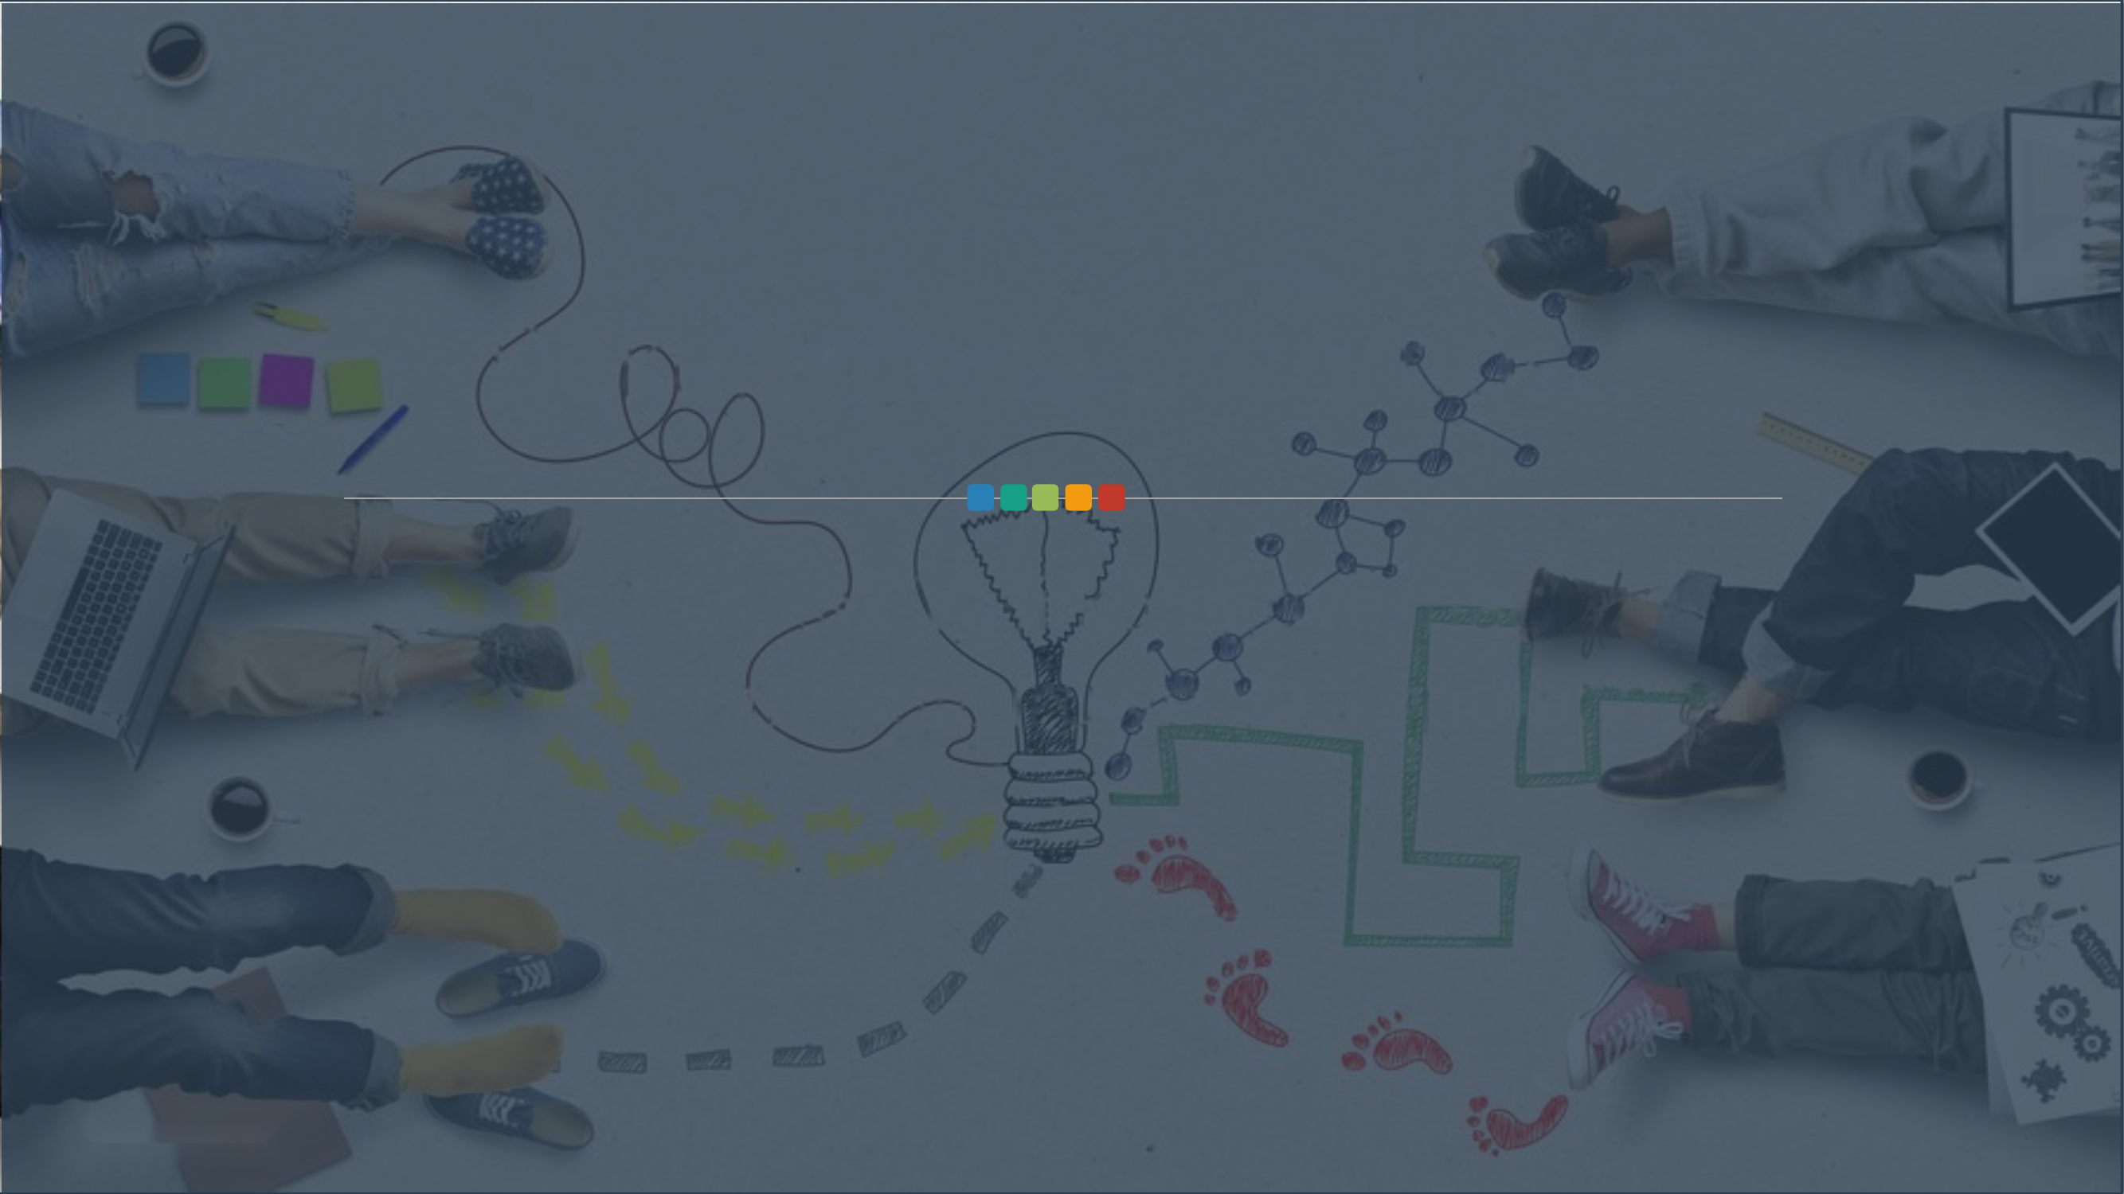
Thank you for your attention!
Curious how your colleagues/managers perceive the corporate culture at your company?
So are we ☺
41 / Corporate Culture

Slide 42
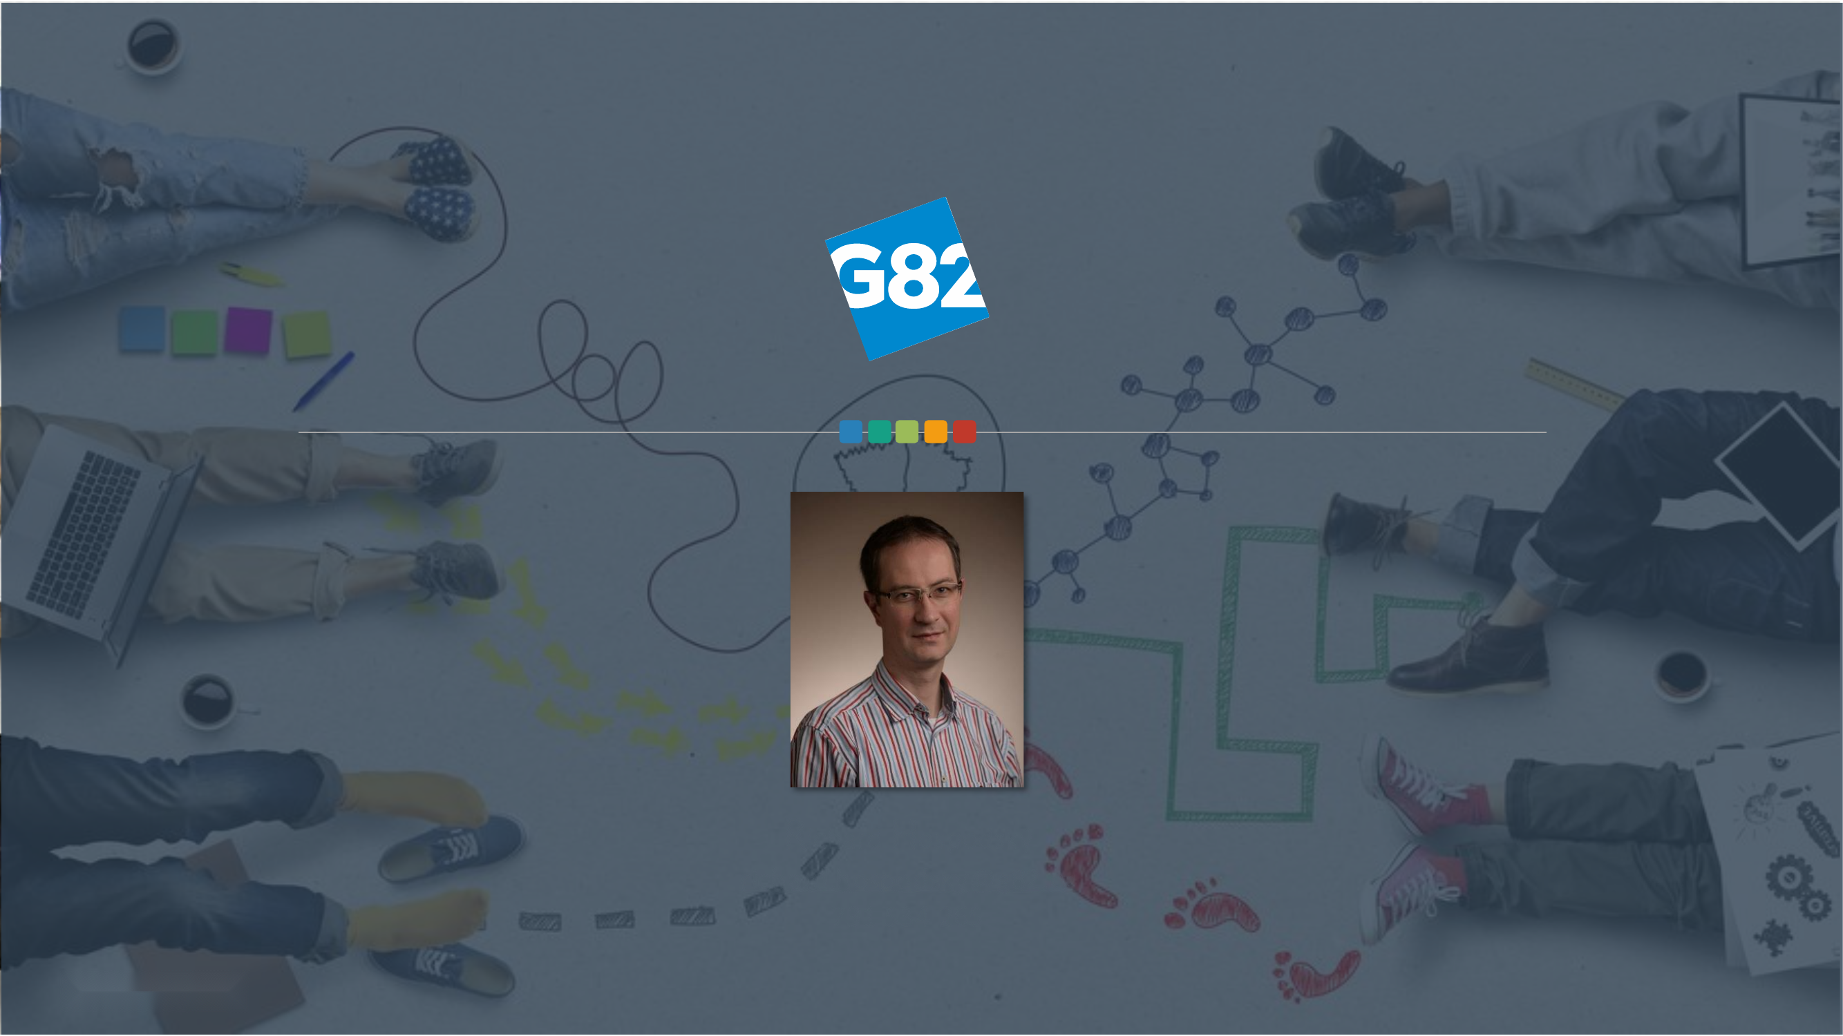
Richard Hospodský
richard.hospodsky@g82.cz 731 534 265

